Slide 1
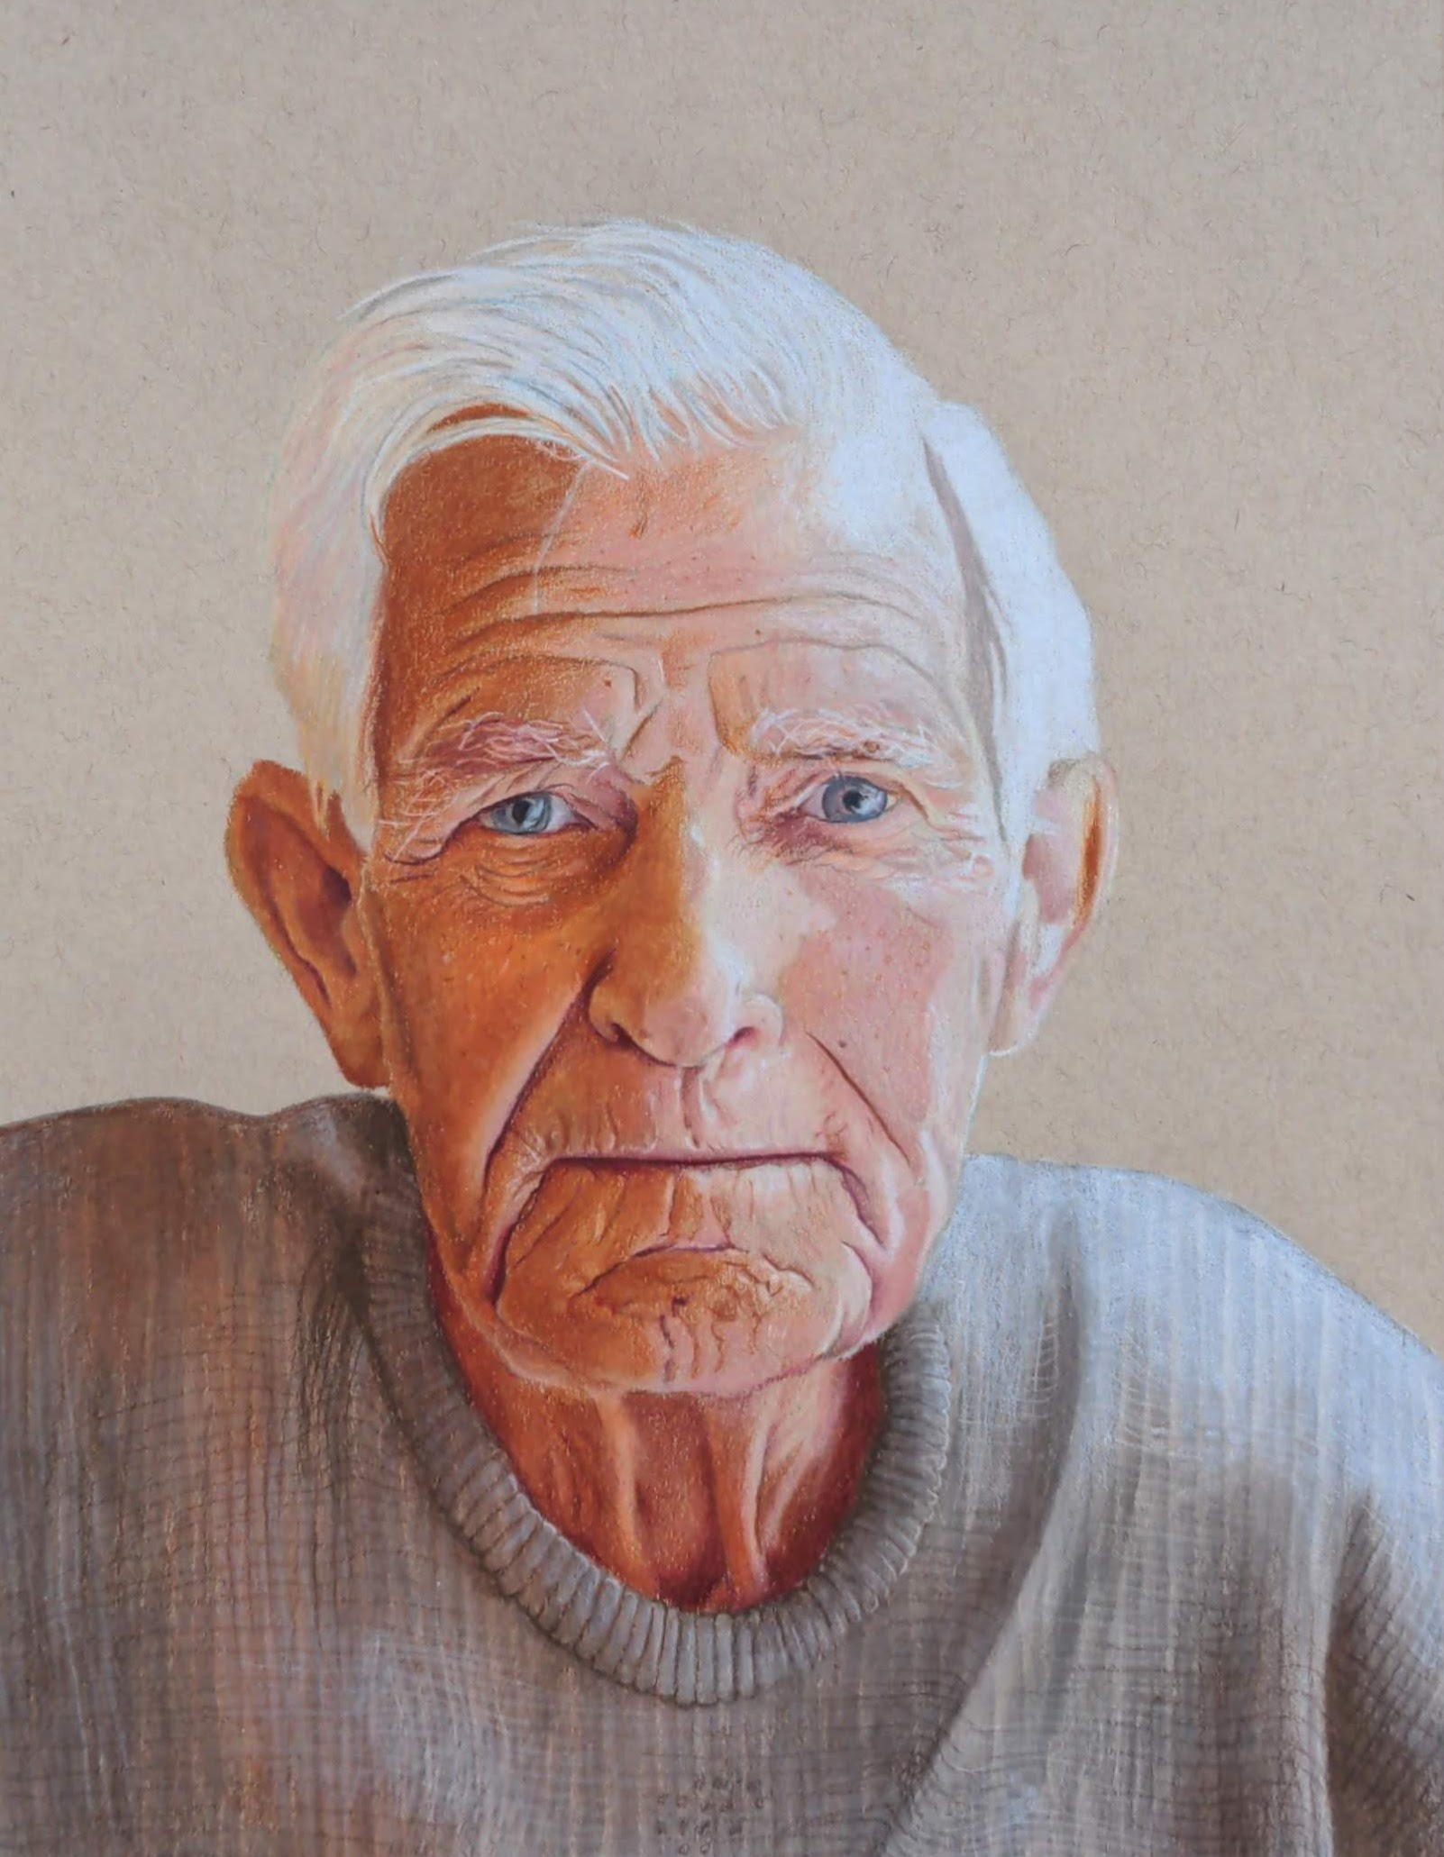
Ageism, infections & vaccinations: Lessons learned from the pandemic
Dr. Dawn Bowdish, PhD
Firestone Institute for Respiratory Health
McMaster University
bowdish@mcmaster.ca
www.bowdish.ca
Instagram/Bluesky: @msmacrophage
Inspired by research in the Bowdish lab.
Artist:Alysa Palazzo @alysa_palazzo_draws

Slide 2


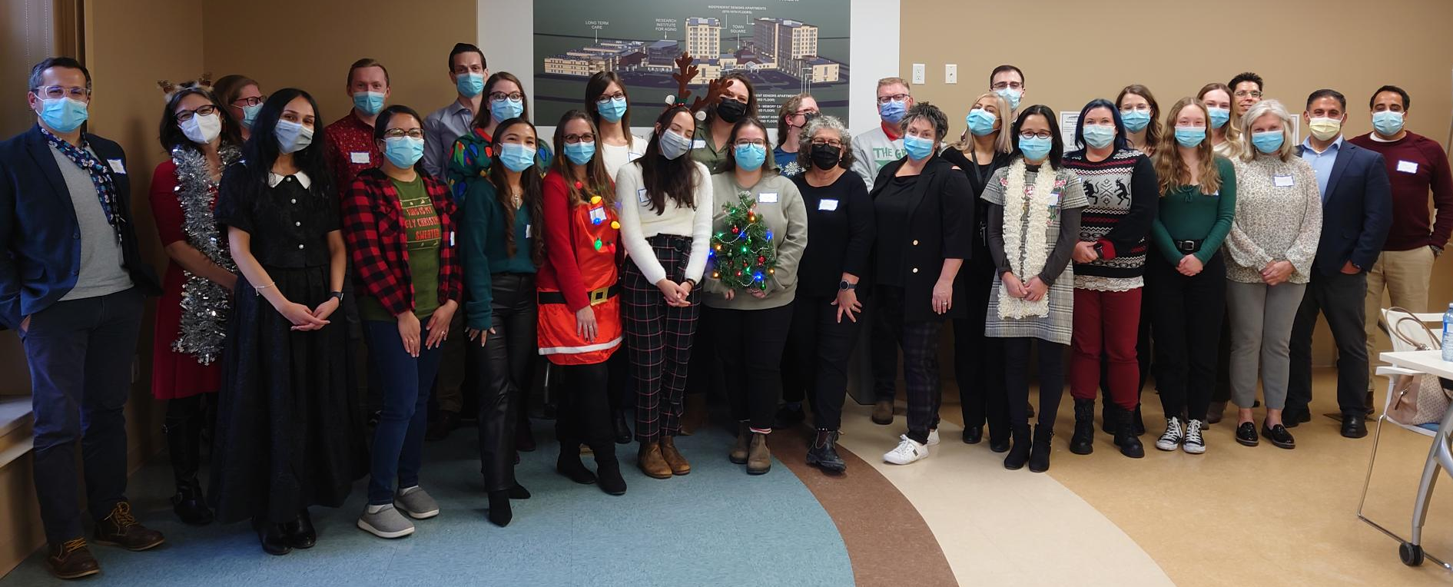
  www.hitsimmune.come
Reshan Rex Shalom Village
Allegra Ferrara Amica Unionville
Deanna Levac Schlegel Villages
Lora Bruyn-Martin Schlegel Villages
Heather Livingstone Hamilton Continuing Care
The Village of Tansley Woods
Julie Garneau Pinehaven Nursing Home
The Village of University Gates
The Village of Winston Park
Mattea Duvnjak Fairview Nursing Home
Melissa Mackinnon The Village of Wentworth Heights
Mithila Vidwans The Village of Erin Meadows
The Village of Humber Heights
Shari Farrugia The Village of Sandalwood Park
Sherline Dorcelus The Village of Taunton Mills
Dana Chausic St. Joseph's Villa Dundas
Josie Lopes St. Joseph's Lifecare Centre Brantford
Rebecka Seilis St. Joseph’s Healthcare Centre Guelph

Slide 3

Ageism kills

Slide 4
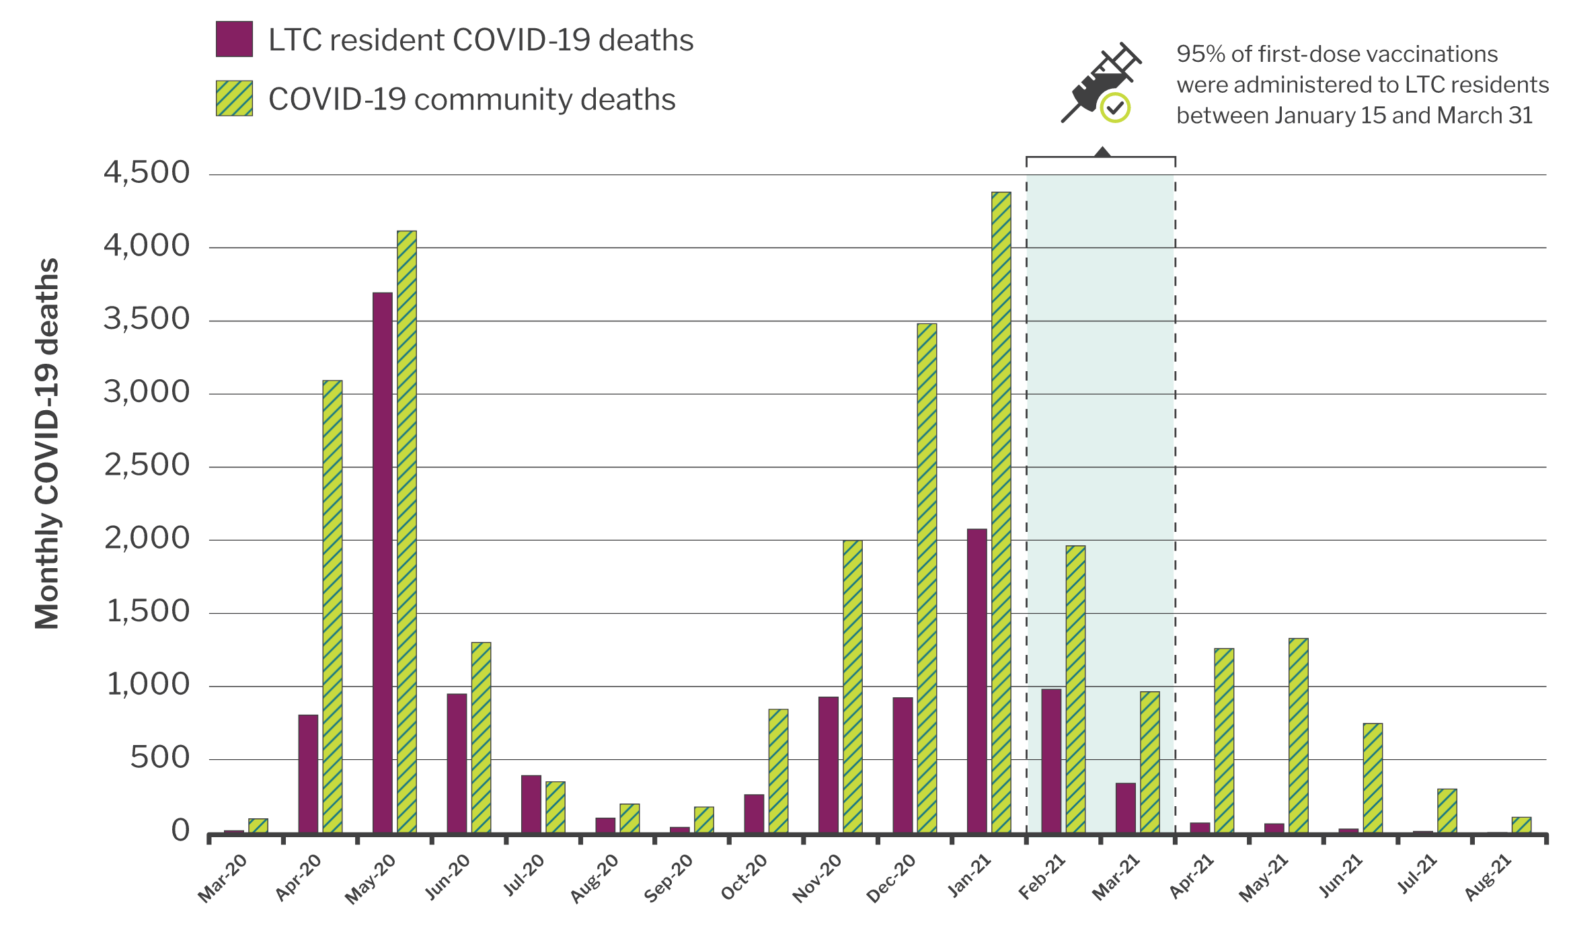

Slide 5
Why do old people get sick?
Thoughts?

Slide 6
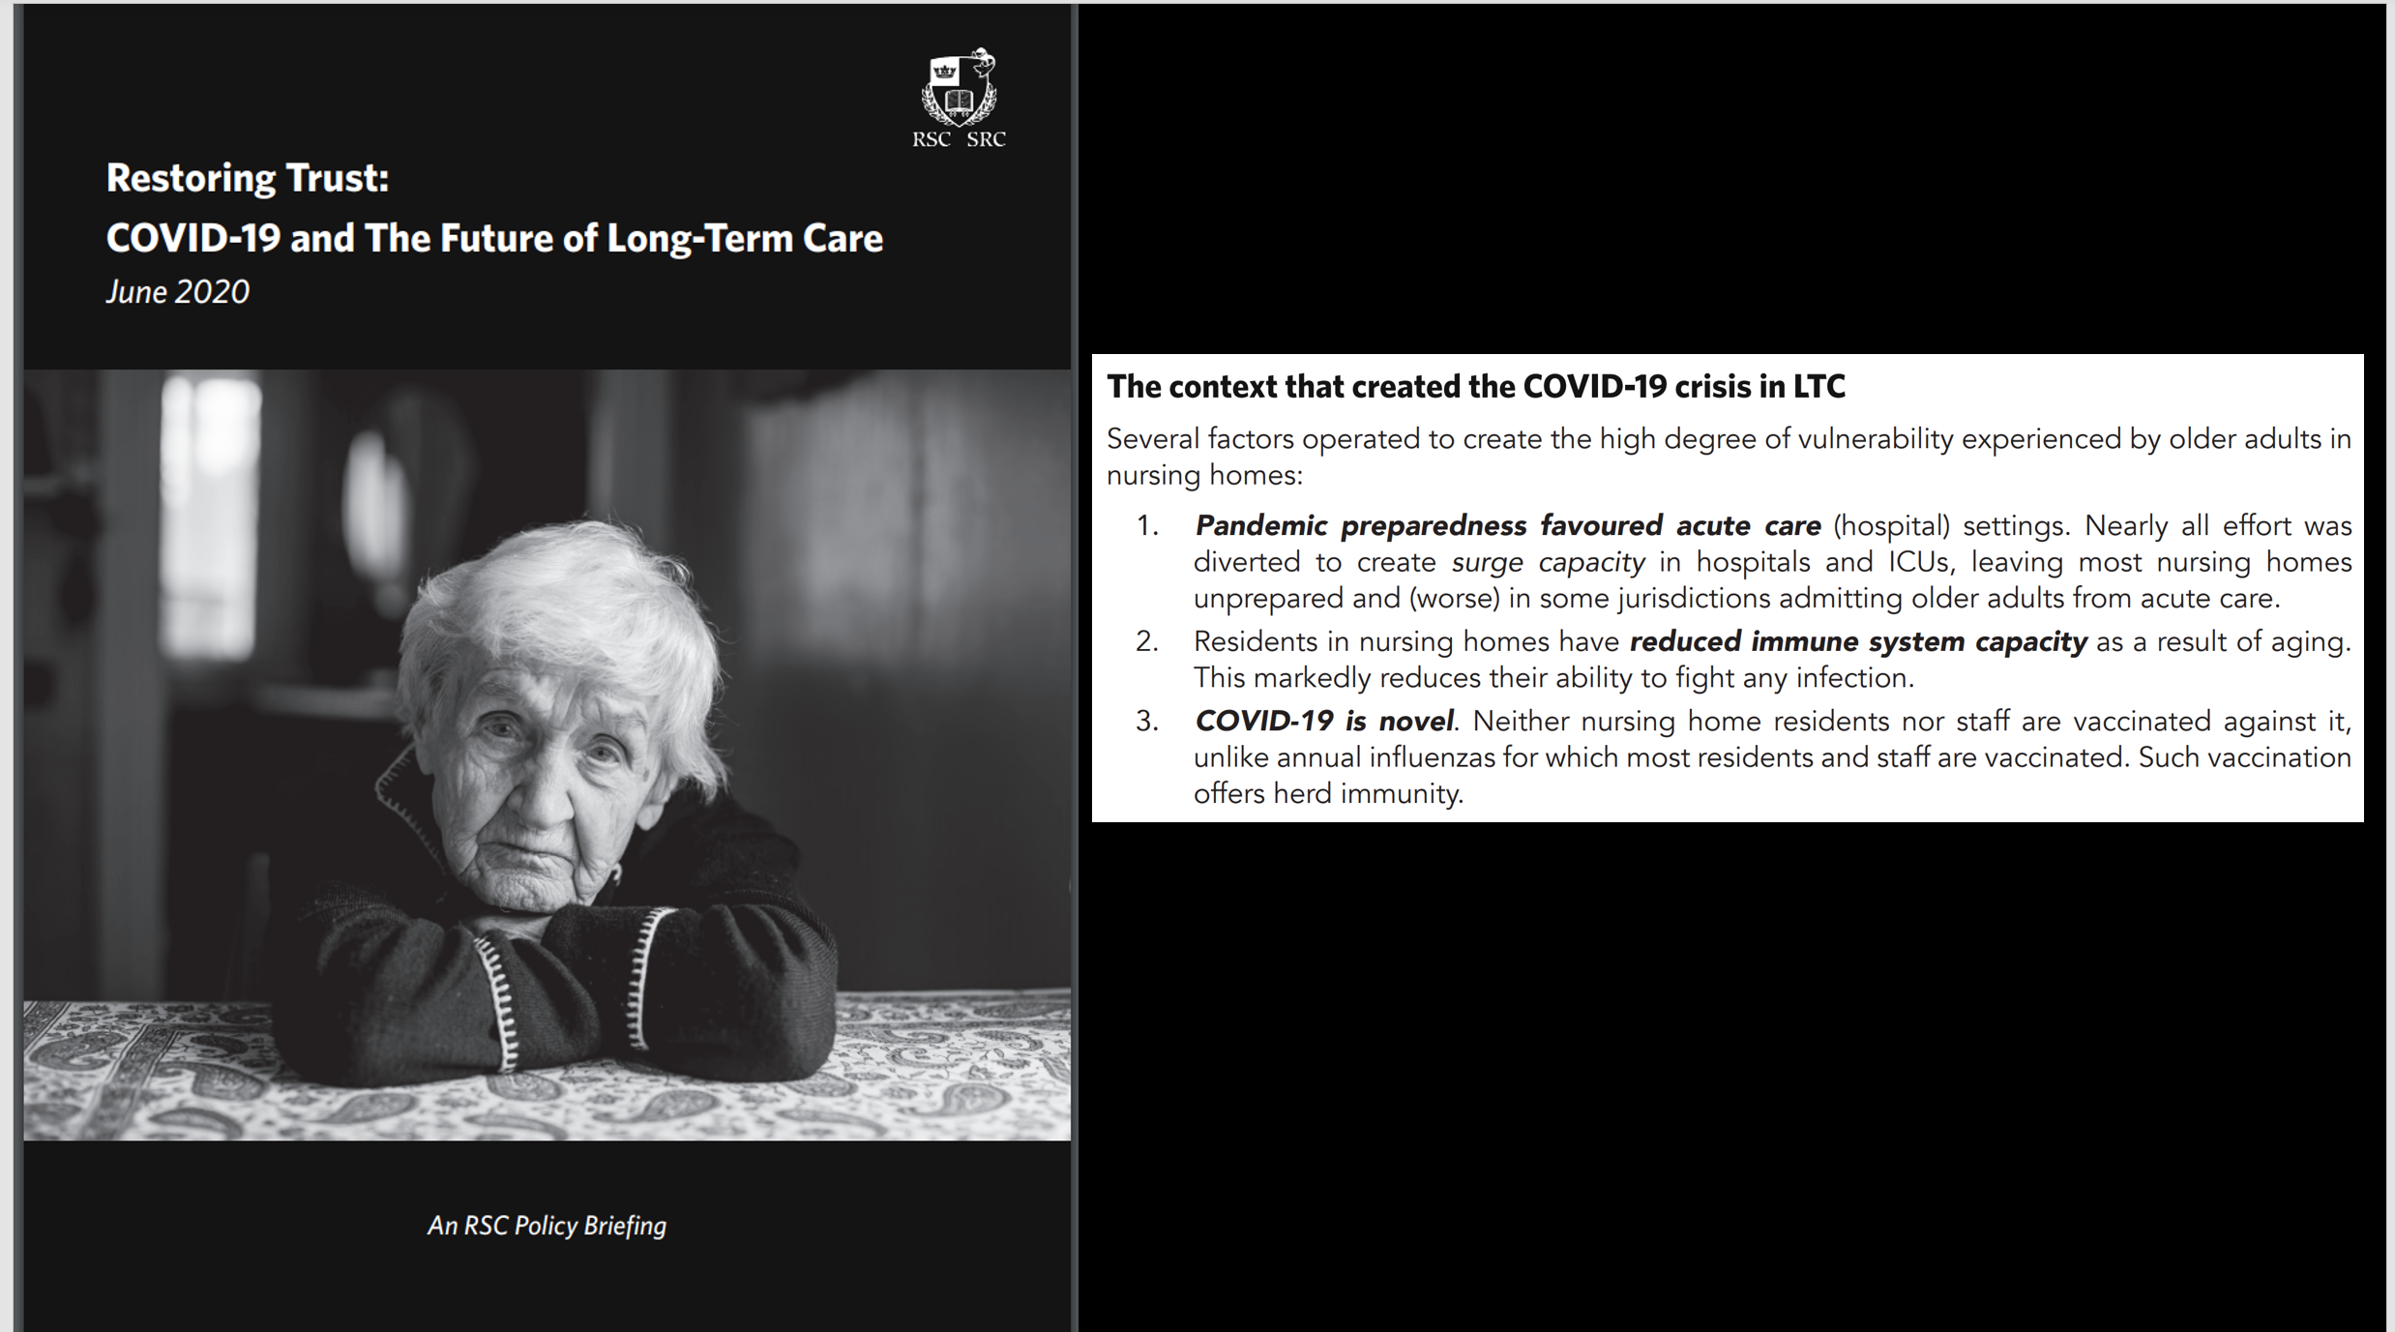

Slide 7
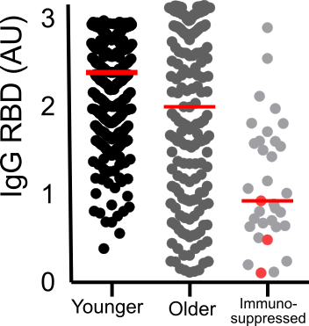
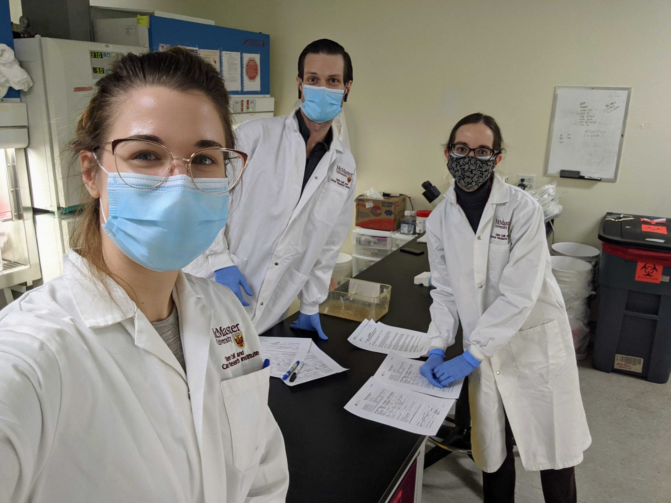
Braeden
Cowborough
Dr. Jessica Breznik
Dr. Allison Kennedy
*data on immunosuppressed populations from Jenna Benoit & Dr. Maggie Larché
*with the support of Megan Hammerman, Jonathan Bramson & the HITS Team

Slide 8


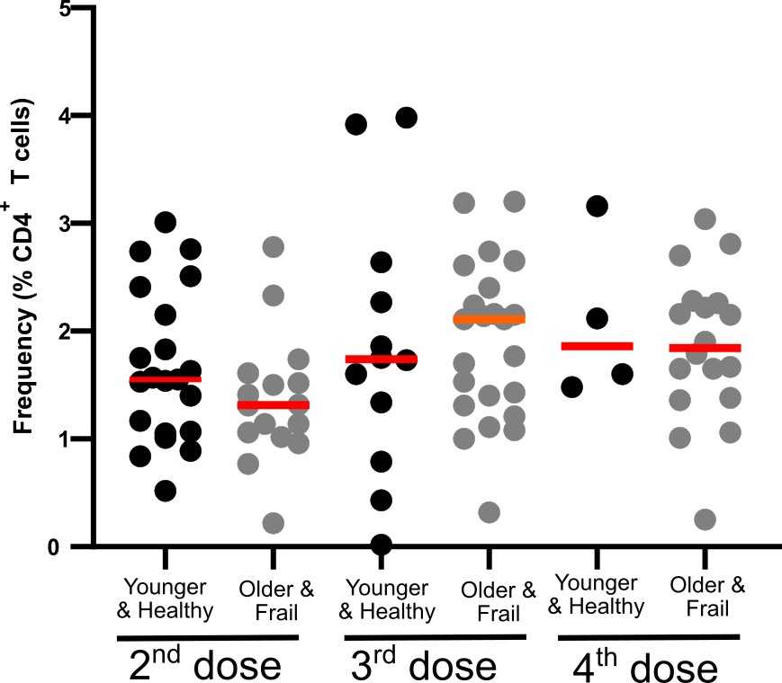
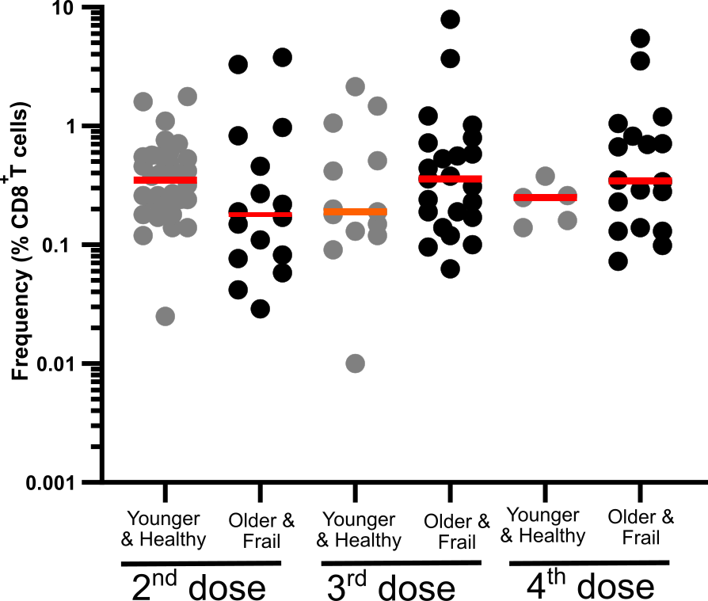


CD4+
CD8+
Cytokine support
Kill virus infected cells
Jenna Benoit, PhD candidate & Dr. Jessica Breznik, PDF

Slide 9
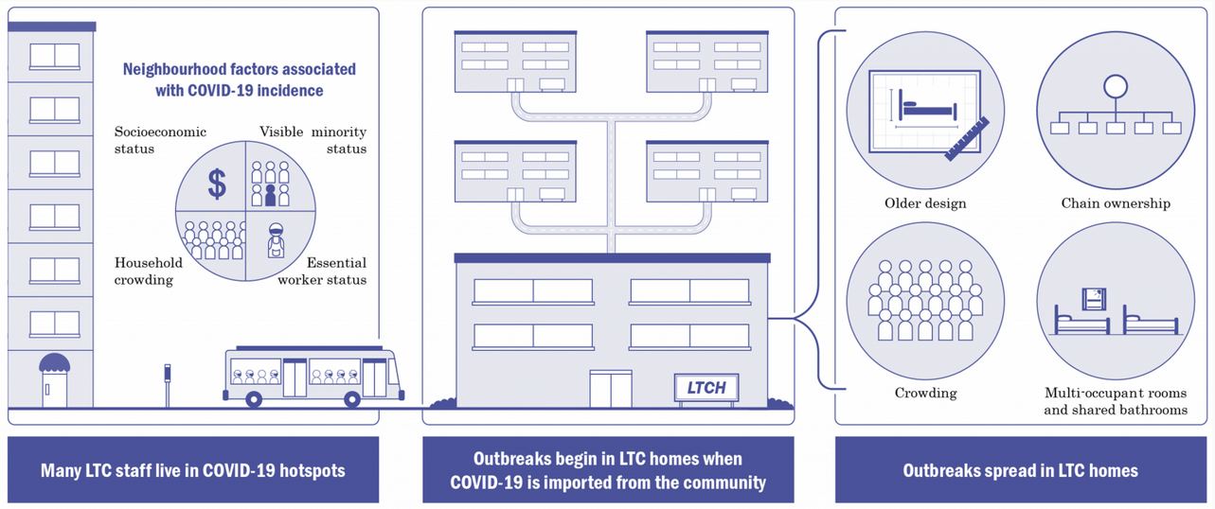
Facility wide factors
Costa, Andrew P., et al. "Risk factors for outbreaks of SARS-CoV-2 at retirement homes in Ontario, Canada: a population-level cohort study." CMAJ. 193.25 (2021): E969-E977.

Slide 10
Only older people or people with health conditions still need to get vaccinated for COVID-19.
True or false

Slide 11
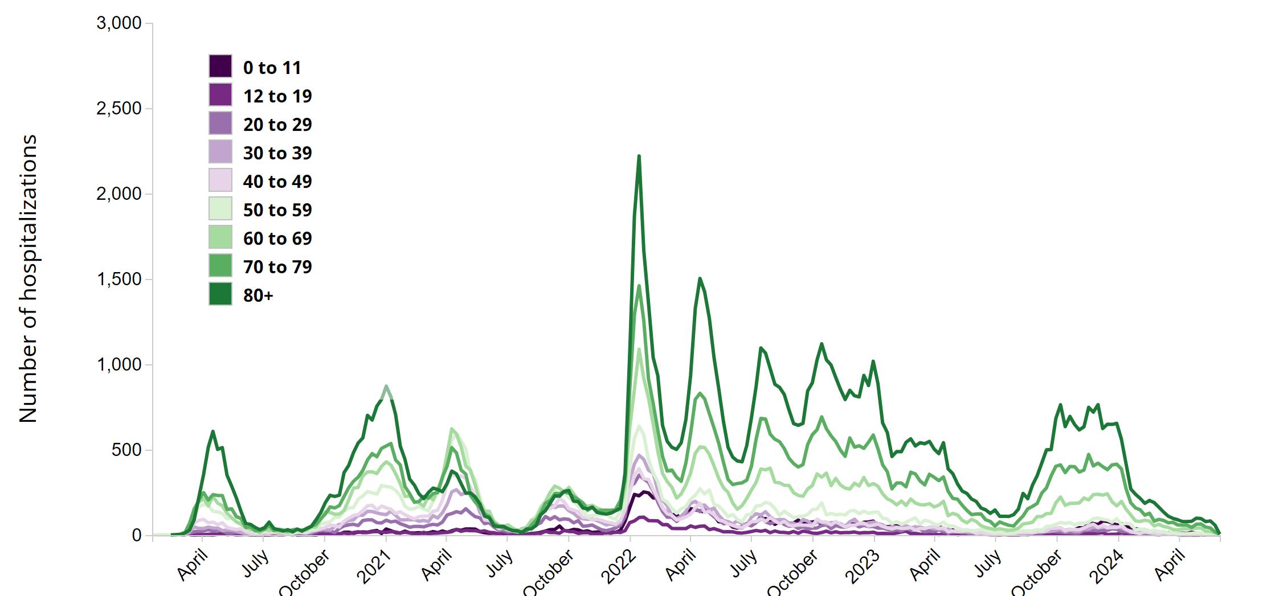
Omicron
BA.1
BA.2
BQ
BA.5
Ancestral
Alpha
EG.5/JN.1
Gamma
Delta
XBB
KP
Data as of June, 2024
https://health-infobase.canada.ca/covid-19/current-situation.html#graphHospVentICU
https://health-infobase.canada.ca/covid-19/current-situation.html#graphHospVentICU

Slide 12
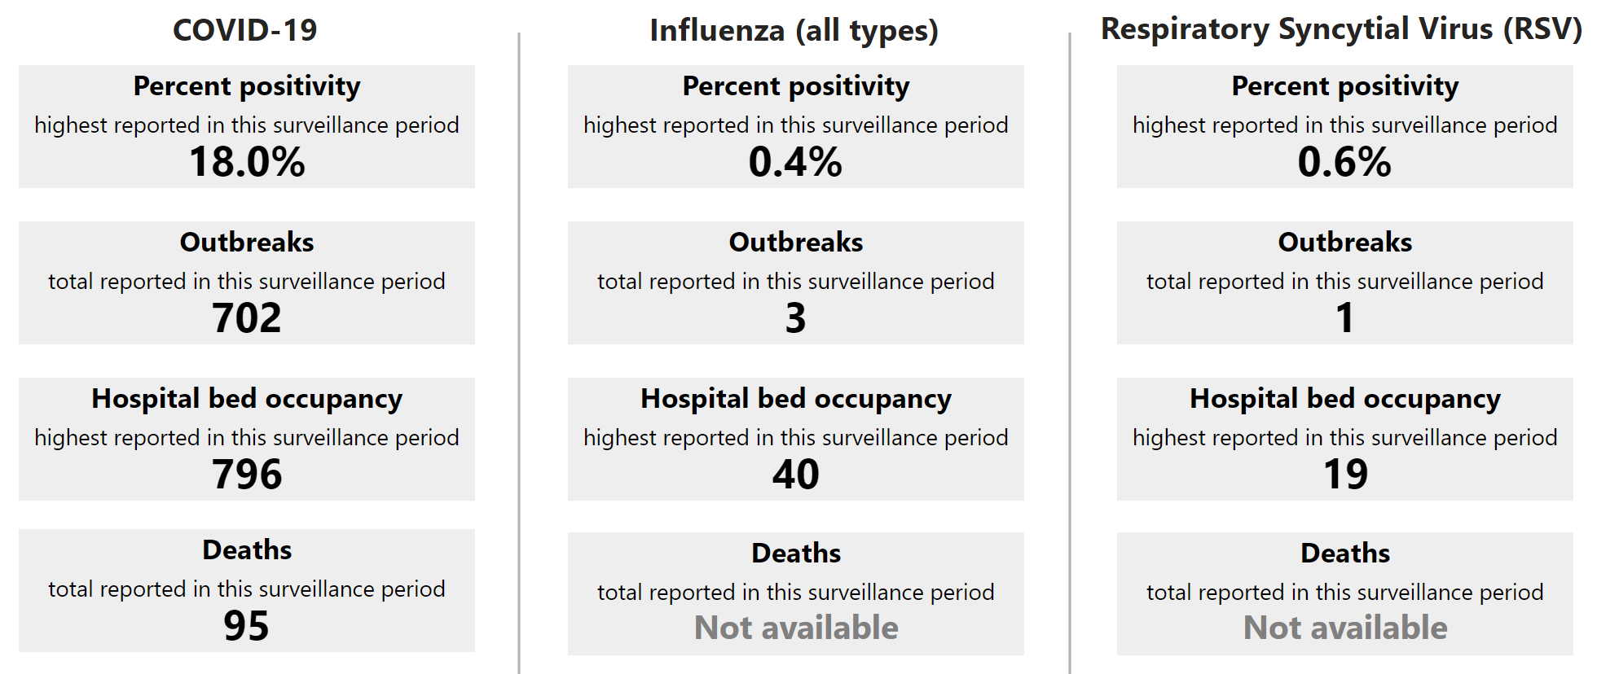
Respiratory virus report August 25 – October 12
https://www.publichealthontario.ca/en/Data-and-Analysis/Infectious-Disease/Respiratory-Virus-Tool

Slide 13










Increased Complexity
Post-hospitalization health issues
Increased Health care needs
Increased LTC needs

Slide 14
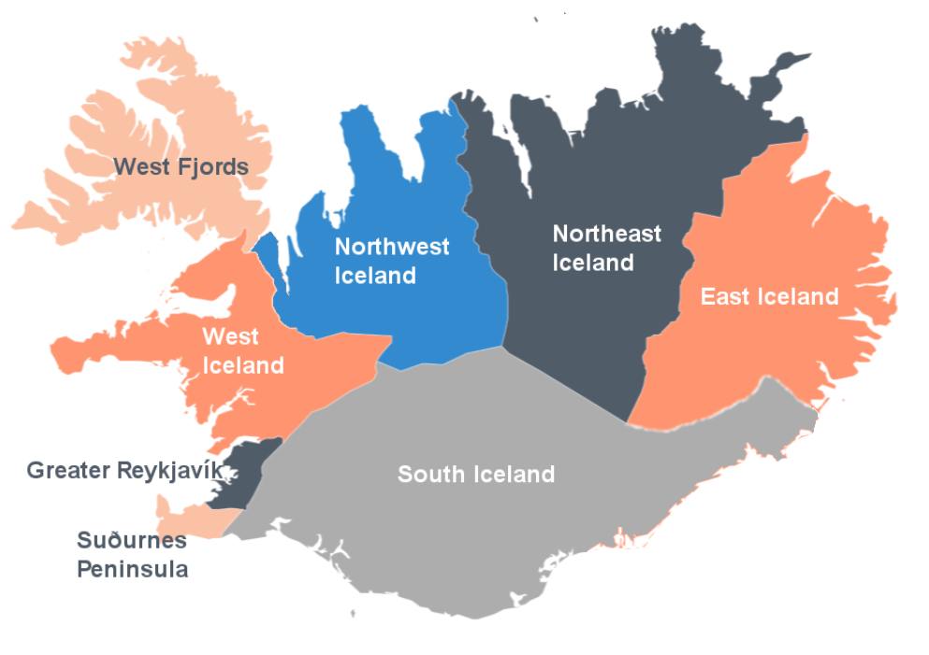
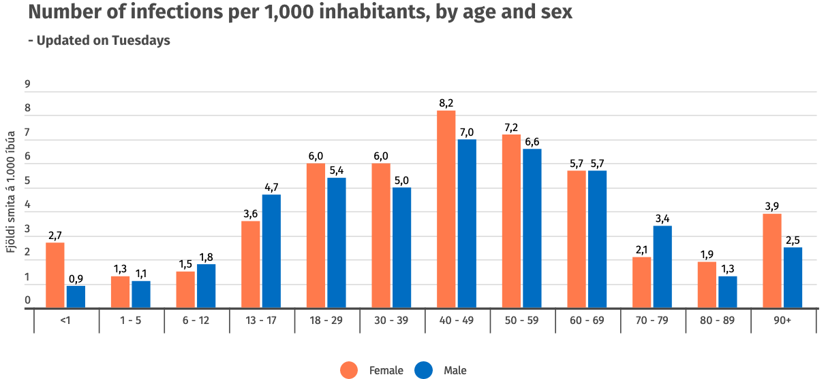
Data from Public Health Iceland June 2022 Gudbjartsson DF, et al., Spread of SARS-CoV-2 in the Icelandic Population. N Engl J Med. 2020 Jun 11;382(24):2302-2315. doi: 10.1056/NEJMoa2006100.

Slide 15
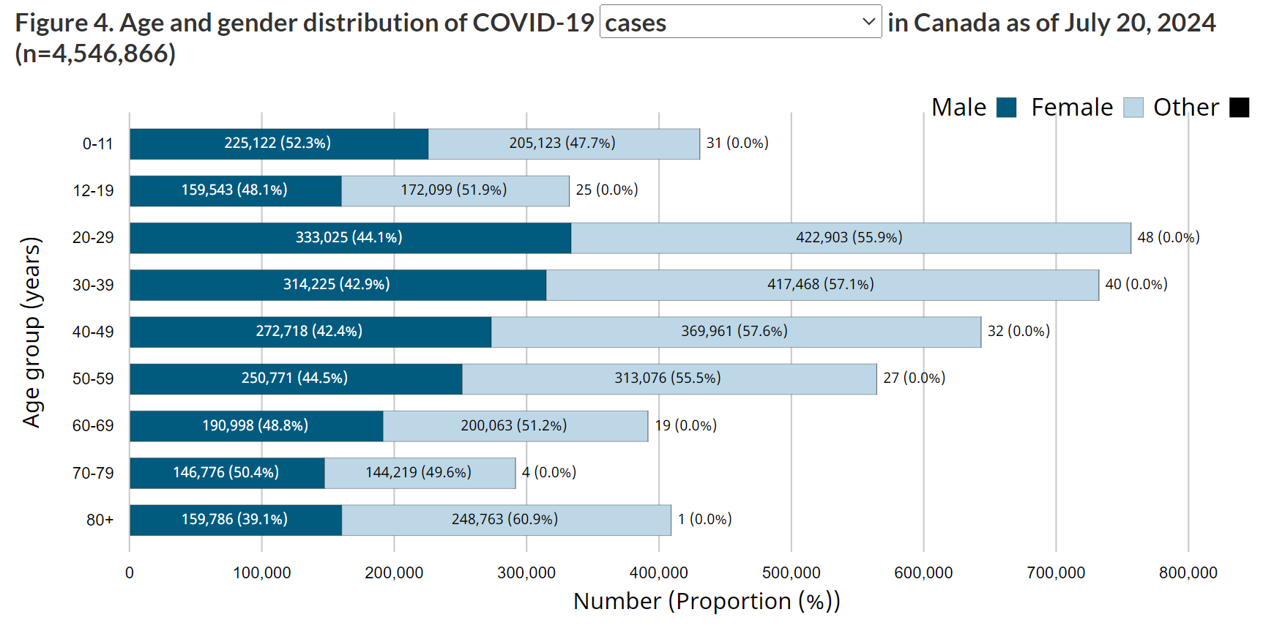
https://health-infobase.canada.ca/covid-19/current-situation.html#figure6-header

Slide 16
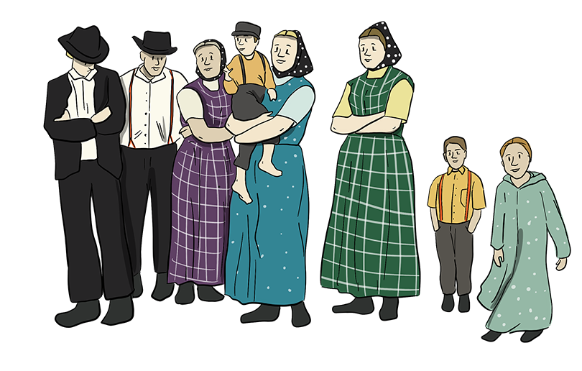
Influenza vaccine
HepA vaccine (control)
Loeb M, et al., Effect of influenza vaccination of children on infection rates in Hutterite communities: a randomized trial. JAMA. 2010 Mar 10;303(10):943-50. doi: 10.1001/jama.2010.250, image from https://exploresaskag.ca/past/immigration/hutterite/

Slide 17
Influenza vaccine
HepA vaccine (control)
61% protection for the whole community!
Loeb M, et al., Effect of influenza vaccination of children on infection rates in Hutterite communities: a randomized trial. JAMA. 2010 Mar 10;303(10):943-50. doi: 10.1001/jama.2010.250, image from https://exploresaskag.ca/past/immigration/hutterite/

Slide 18
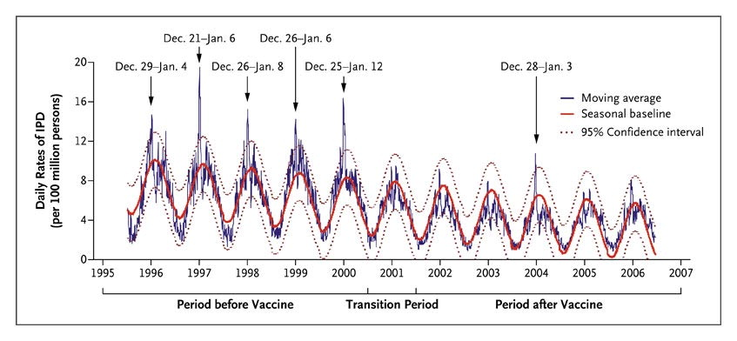
Incidence of Invasive Pneumococcal Disease, According to Data from Active Population-Based Surveillance, 1995–2006.
Pneumococcal vaccination
Walter ND, et al, Active Bacterial Core Surveillance System Team. Holiday spikes in pneumococcal disease among older adults. N Engl J Med. 2009 Dec 24;361(26):2584-5.
Walter ND et al. N Engl J Med 2009;361:2584-2585.

Slide 19
COVID-19 vaccines work as well or better than influenza vaccines
…but have reasonable expectations.

Slide 20

Effectiveness of Seasonal Flu Vaccines from the 2005 – 2021 Flu Seasons
*2020-2021 flu vaccine effectiveness was not estimated due to low flu virus circulation during the 2020-2021 flu season.
Vaccine. 2018 Feb 28; 36(10): 1272–1278.
Source: https://www.cdc.gov/flu/professionals/vaccination/effectiveness-studies.htm
Notes:
While CDC began estimating influenza vaccine effectiveness annually in 2004–05, this slide captures data beginning in 2008-2009 when the U.S. Influenza Vaccine Effectiveness Network (U.S. Flu VE Network) began. Earlier estimates may not have been representative because they were from only one site.

Slide 21
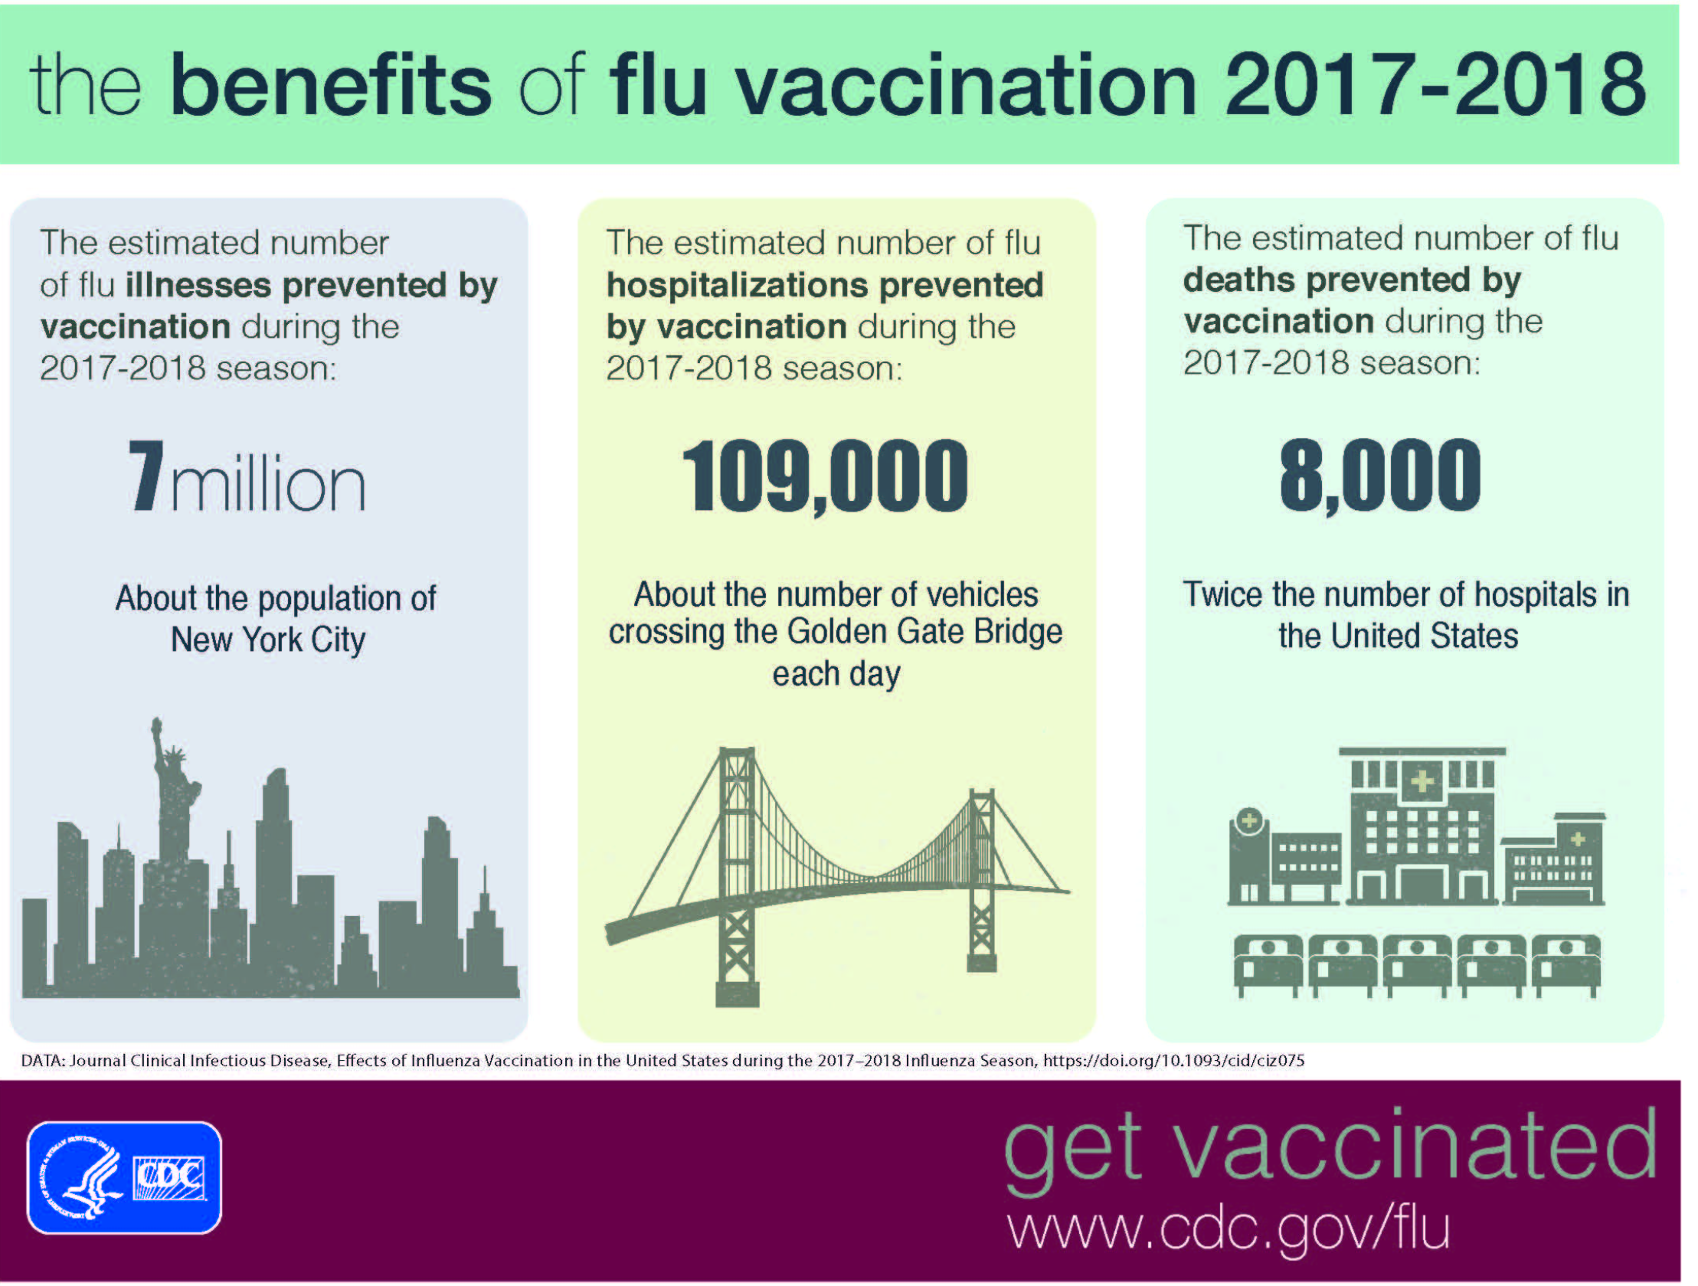
https://www.cdc.gov/flu/professionals/vaccination/effectiveness-studies.htm

Slide 22
38% efficacy
https://www.cdc.gov/flu/professionals/vaccination/effectiveness-studies.htm

Slide 23
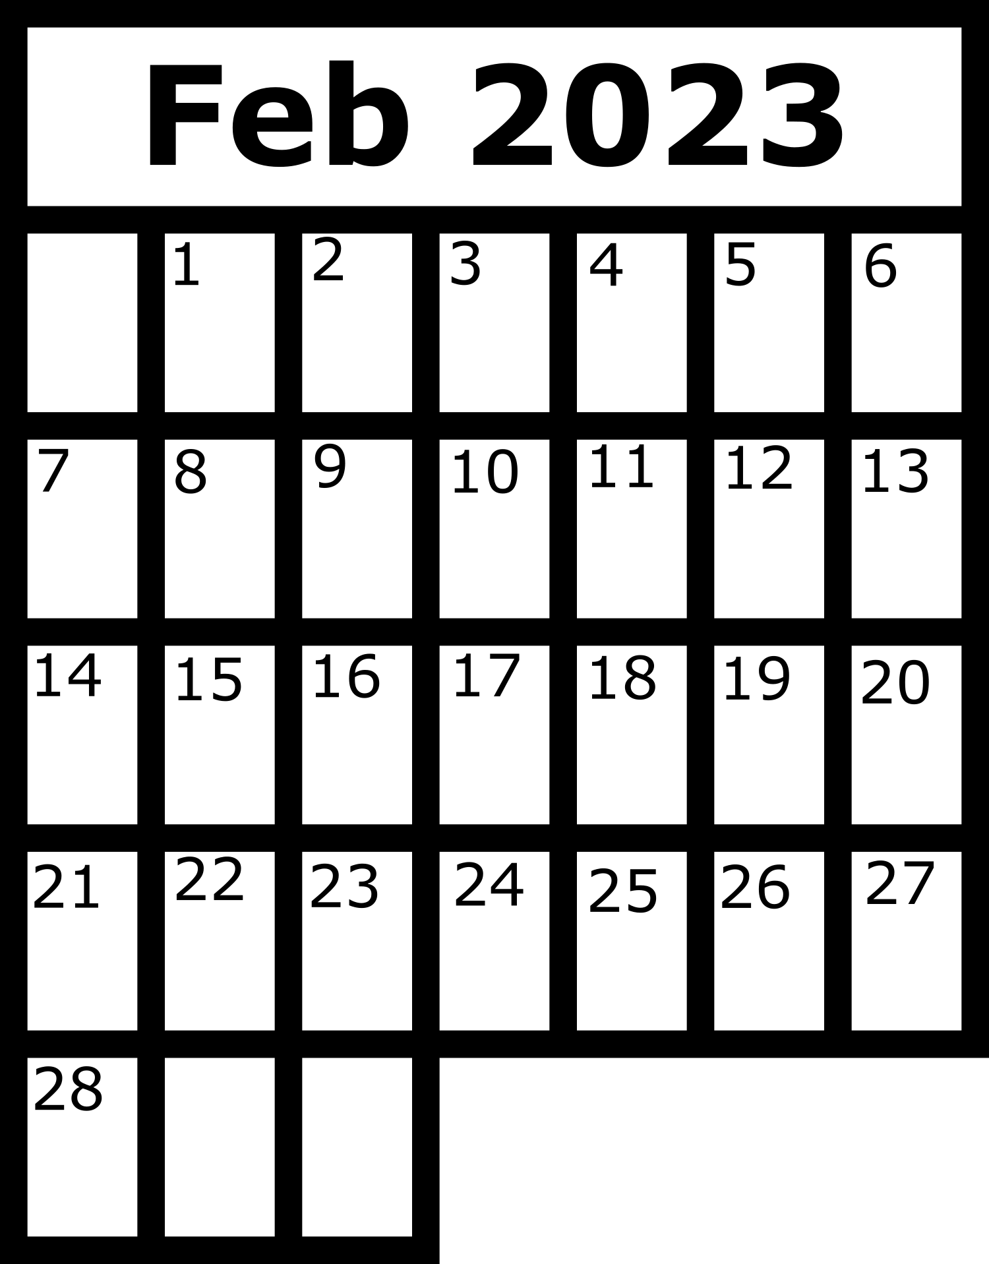

If immunized against influenza...
…less likely to be hospitalized.
…shorter hospital stay.
X
X
X
X
…fewer heart attacks/strokes.
…less likely to develop ‘catastrophic disability’, more likely to be able to live independently.
Arriola C,. Influenza Vaccination Modifies Disease Severity Among Community-dwelling Adults Hospitalized With Influenza. Clin Infect Dis. 2017 Oct 15;65(8):1289-1297. doi: 10.1093/cid/cix468.

Slide 25
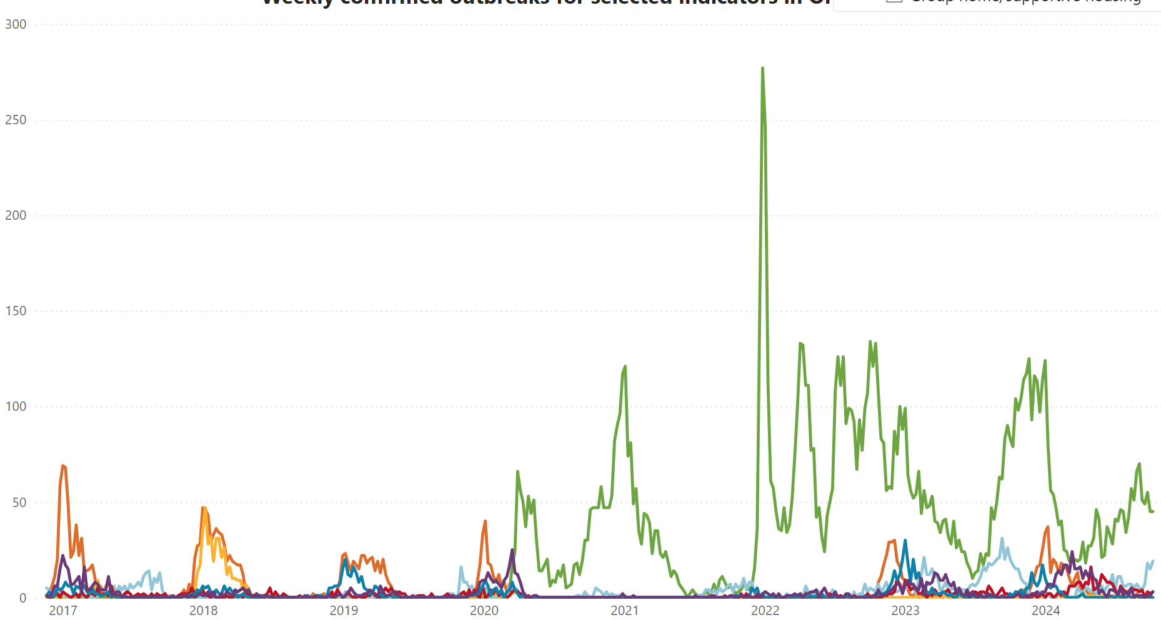
Outbreaks in retirement homes & long-term care
COVID-19
Influenza B
Influenza A
Entero/Rhinovirus
# of Outbreaks
Parainfluenza (all types)
Respiratory syncytial virus
Other pathogens

Slide 26
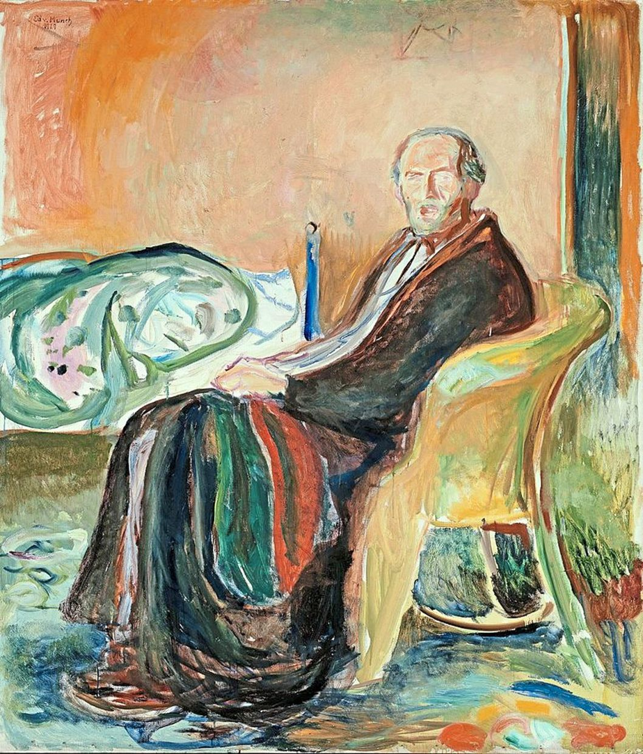

  The aging immune system does some things very well
  COVID-19 vaccines work better than expected
  Vaccines will be required for new variants, just as influenza vaccines are required for new strains
  Ageism kills!
Edvard Munch’s
'Self-Portrait After The Spanish Flu' (1919).

Slide 27

The perils of being born in the Fall

Slide 28
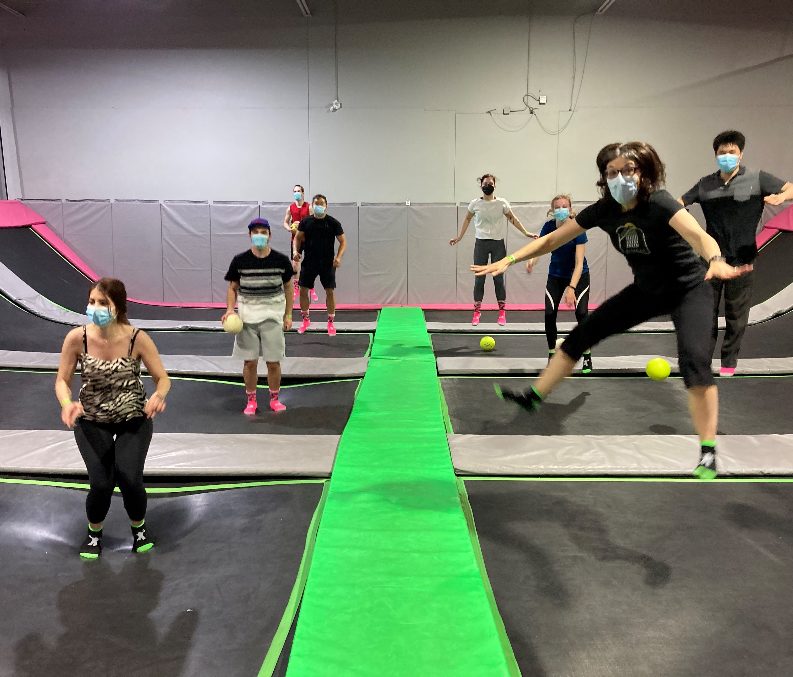
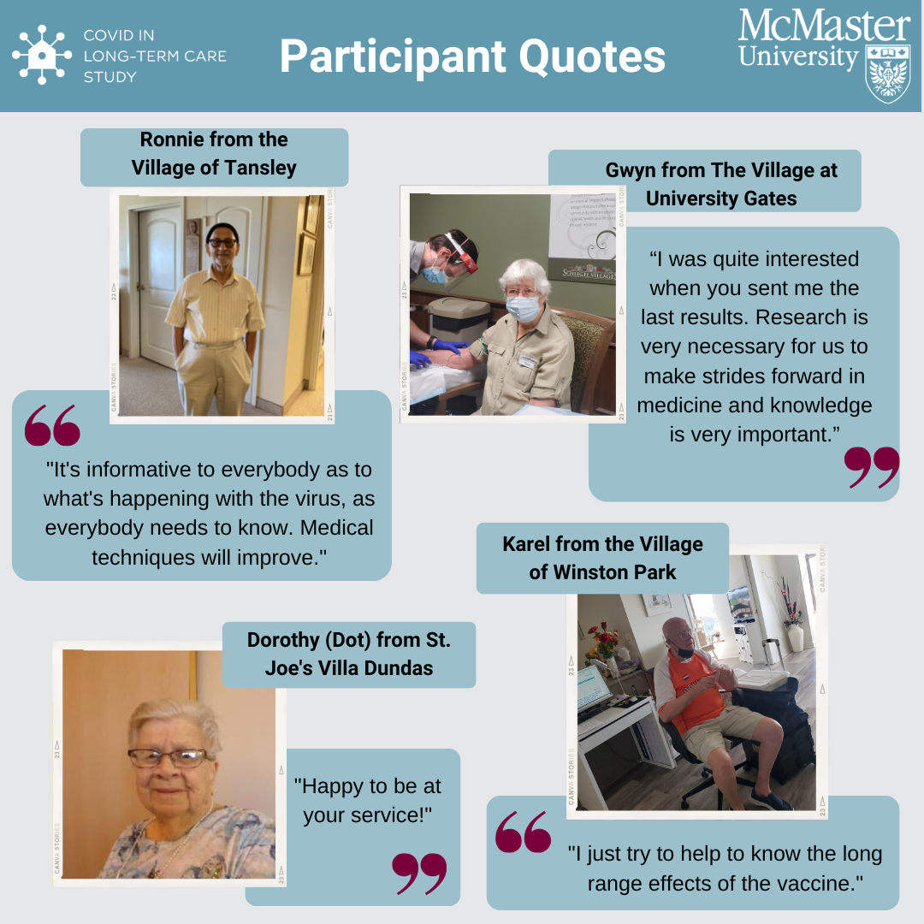

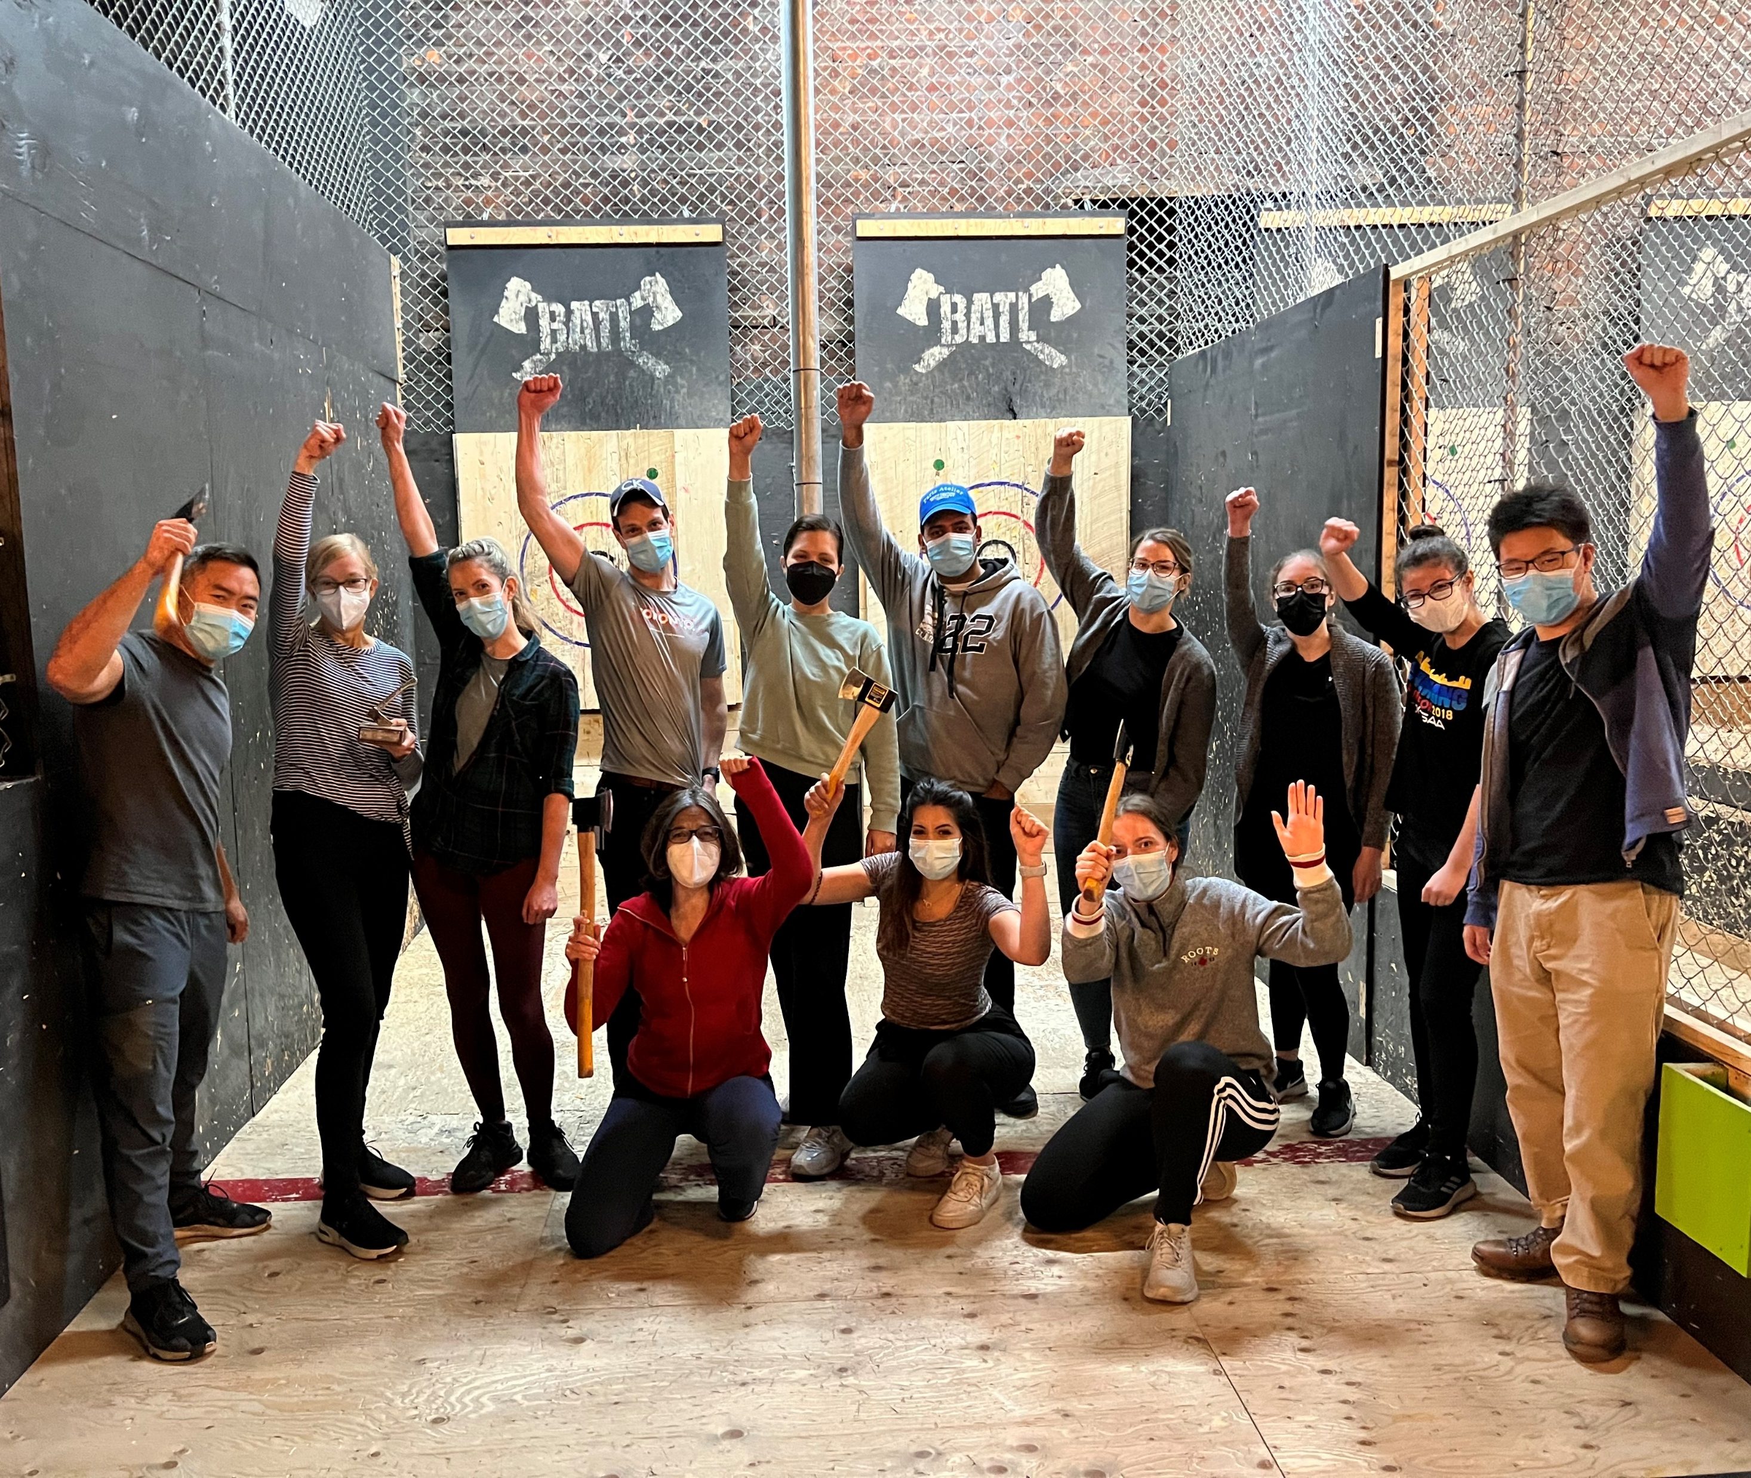
bowdish@mcmaster.ca www.bowdish.ca Insta/Bluesky: @MsMacrophage

