Slide 1
COVID-19/SARS-CoV-2 & back to school
September 3, 2020
Dr. Dawn Bowdish, PhD
Canada Research Chair in Aging
McMaster University
bowdish@mcmaster.ca
www.bowdish.ca
Twitter & Instagram: @MsMacrophage
Part 2

Slide 2
Can schools open safely?
Only with vigilance, adaptability and major adjustments.

Slide 3
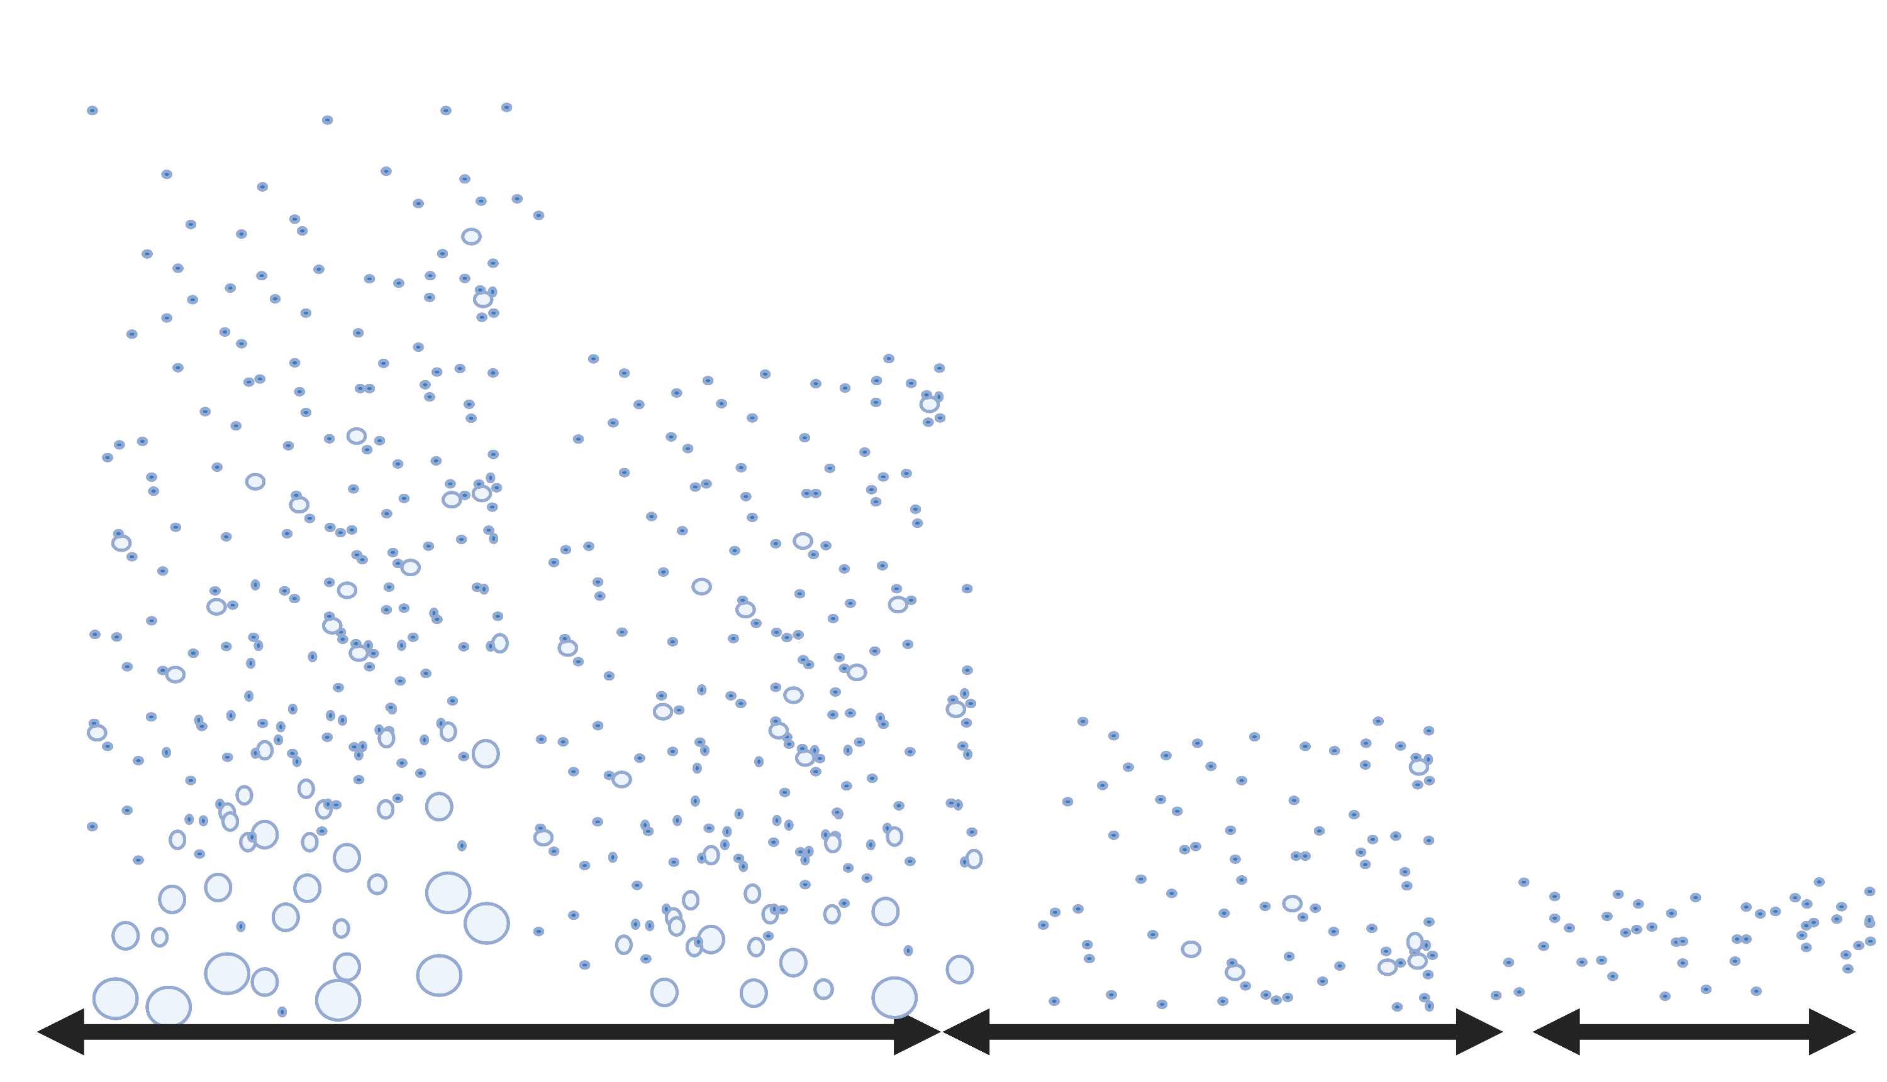
Coughing/
Sneezing
Singing/
Shouting
Talking
Breathing
5 – 15 min
45 min
45 min+

Slide 4
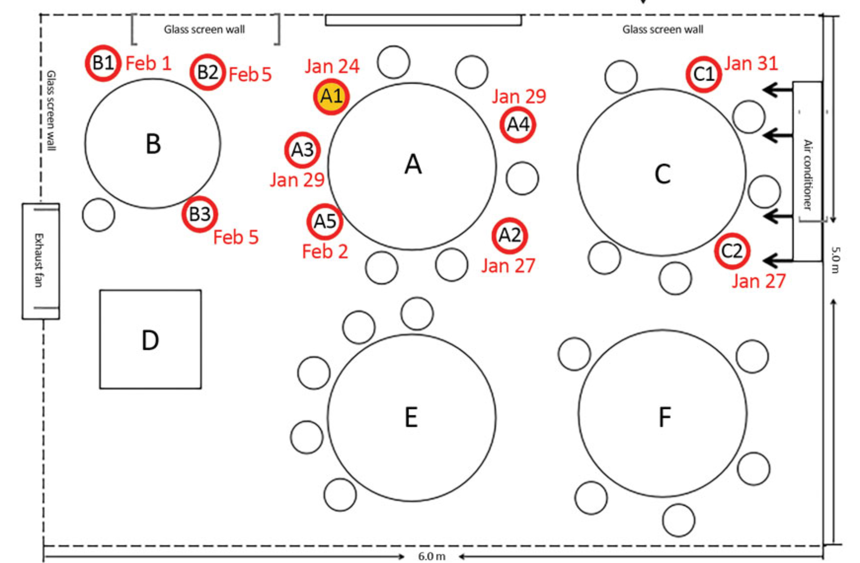
The importance of air flow
Lu J, et al. COVID-19 Outbreak Associated with Air Conditioning in Restaurant, Guangzhou, China, 2020. Emerg Infect Dis. 2020;26(7):1628-1631. https://dx.doi.org/10.3201/eid2607.200764
https://wwwnc.cdc.gov/eid/article/26/7/20-0764_article

Slide 5
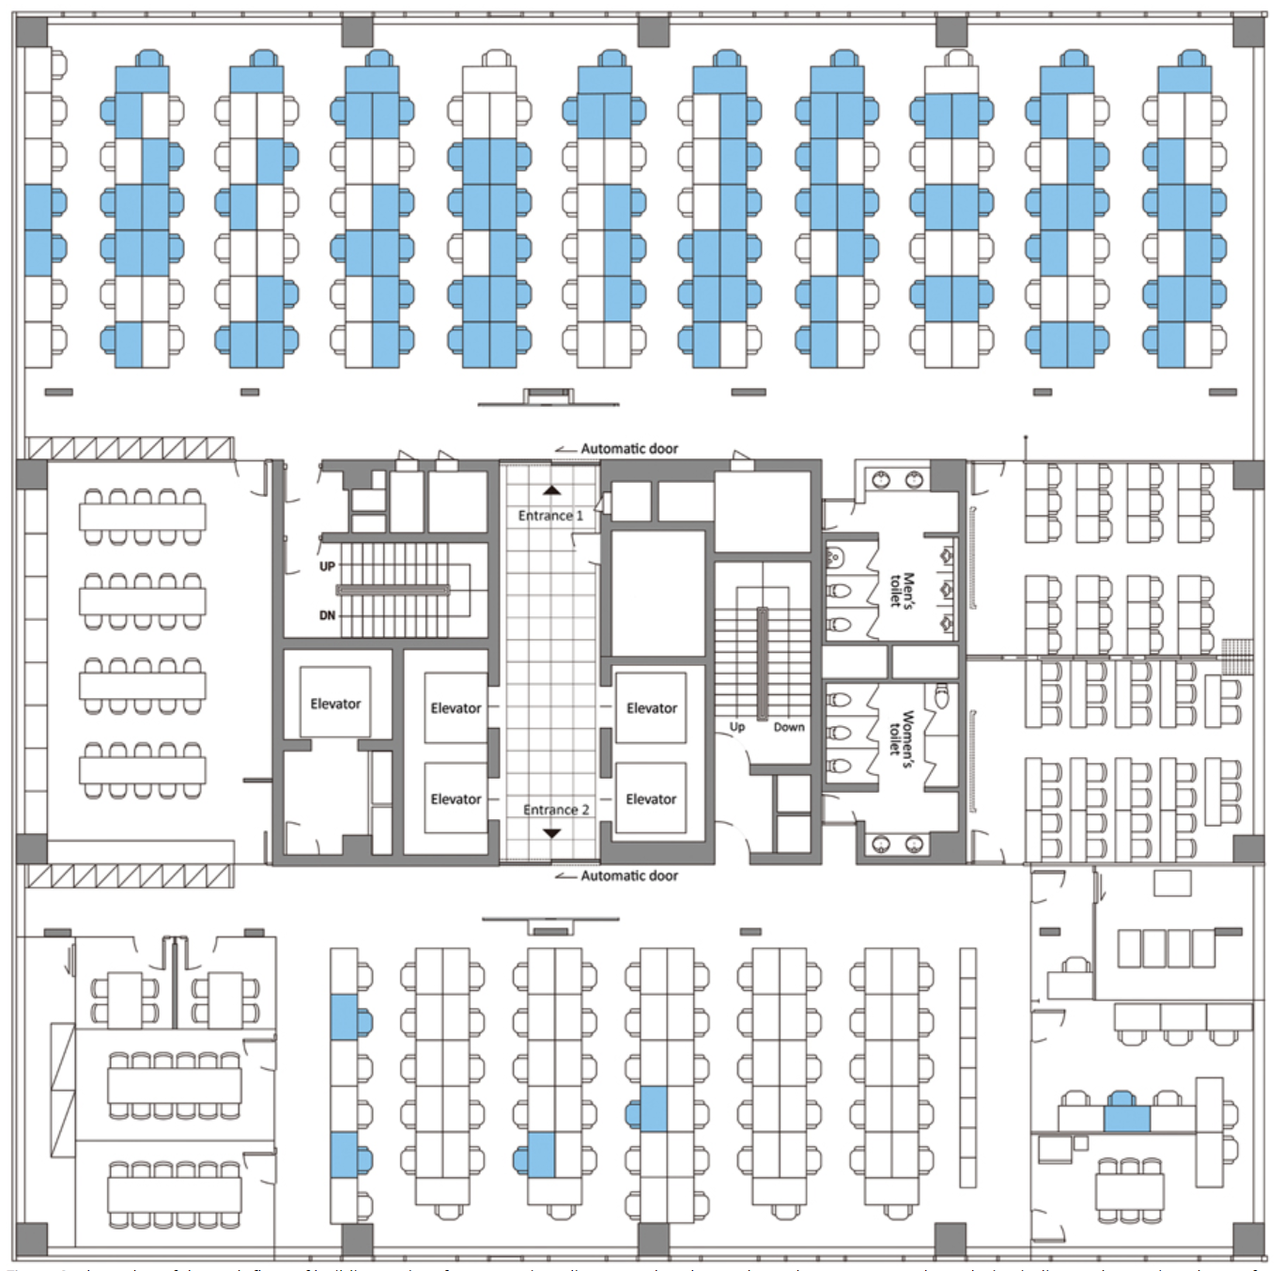
The importance of air flow
Park SY, Kim YM, Yi S, Lee S, Na BJ, Kim CB, et al. Coronavirus disease outbreak in call center, South Korea. Emerg Infect Dis. 2020 Aug https://doi.org/10.3201/eid2608.201274

Slide 7
Increasing ventilation reduces risk
Video available at https://www.youtube.com/watch?v=59tQeL0ehbMNHK WORLD-JAPAN
NHK WORLD-JAPAN
https://www.youtube.com/watch?v=59tQeL0ehbMNHK WORLD-JAPAN

Slide 8
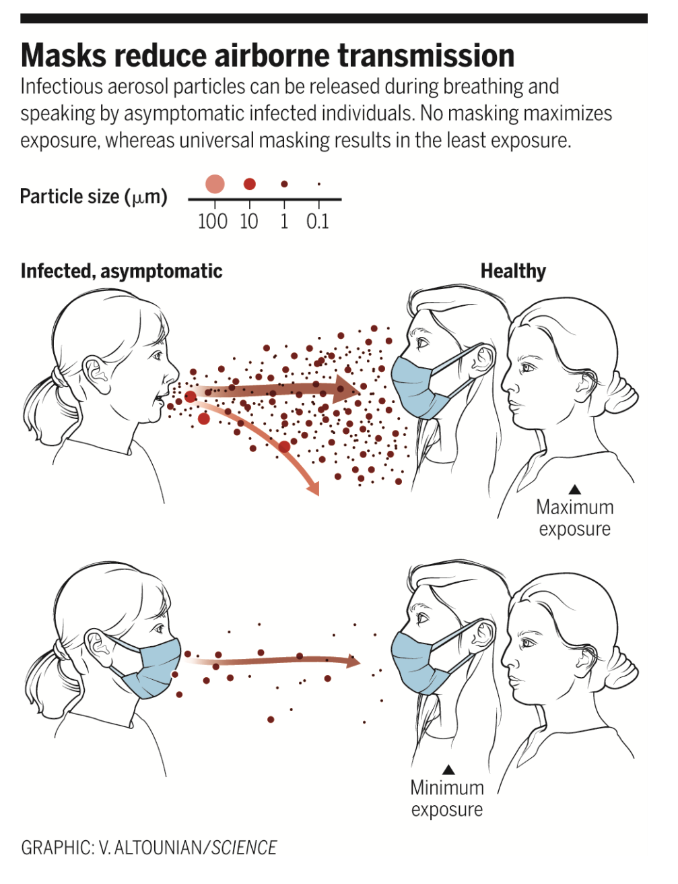
Masks reduce risk by:
Keeping droplets away from others
Keeping droplets out of the air
K. A. Prather et al., Science.10.1126/science.abc6197 (2020).

Slide 9
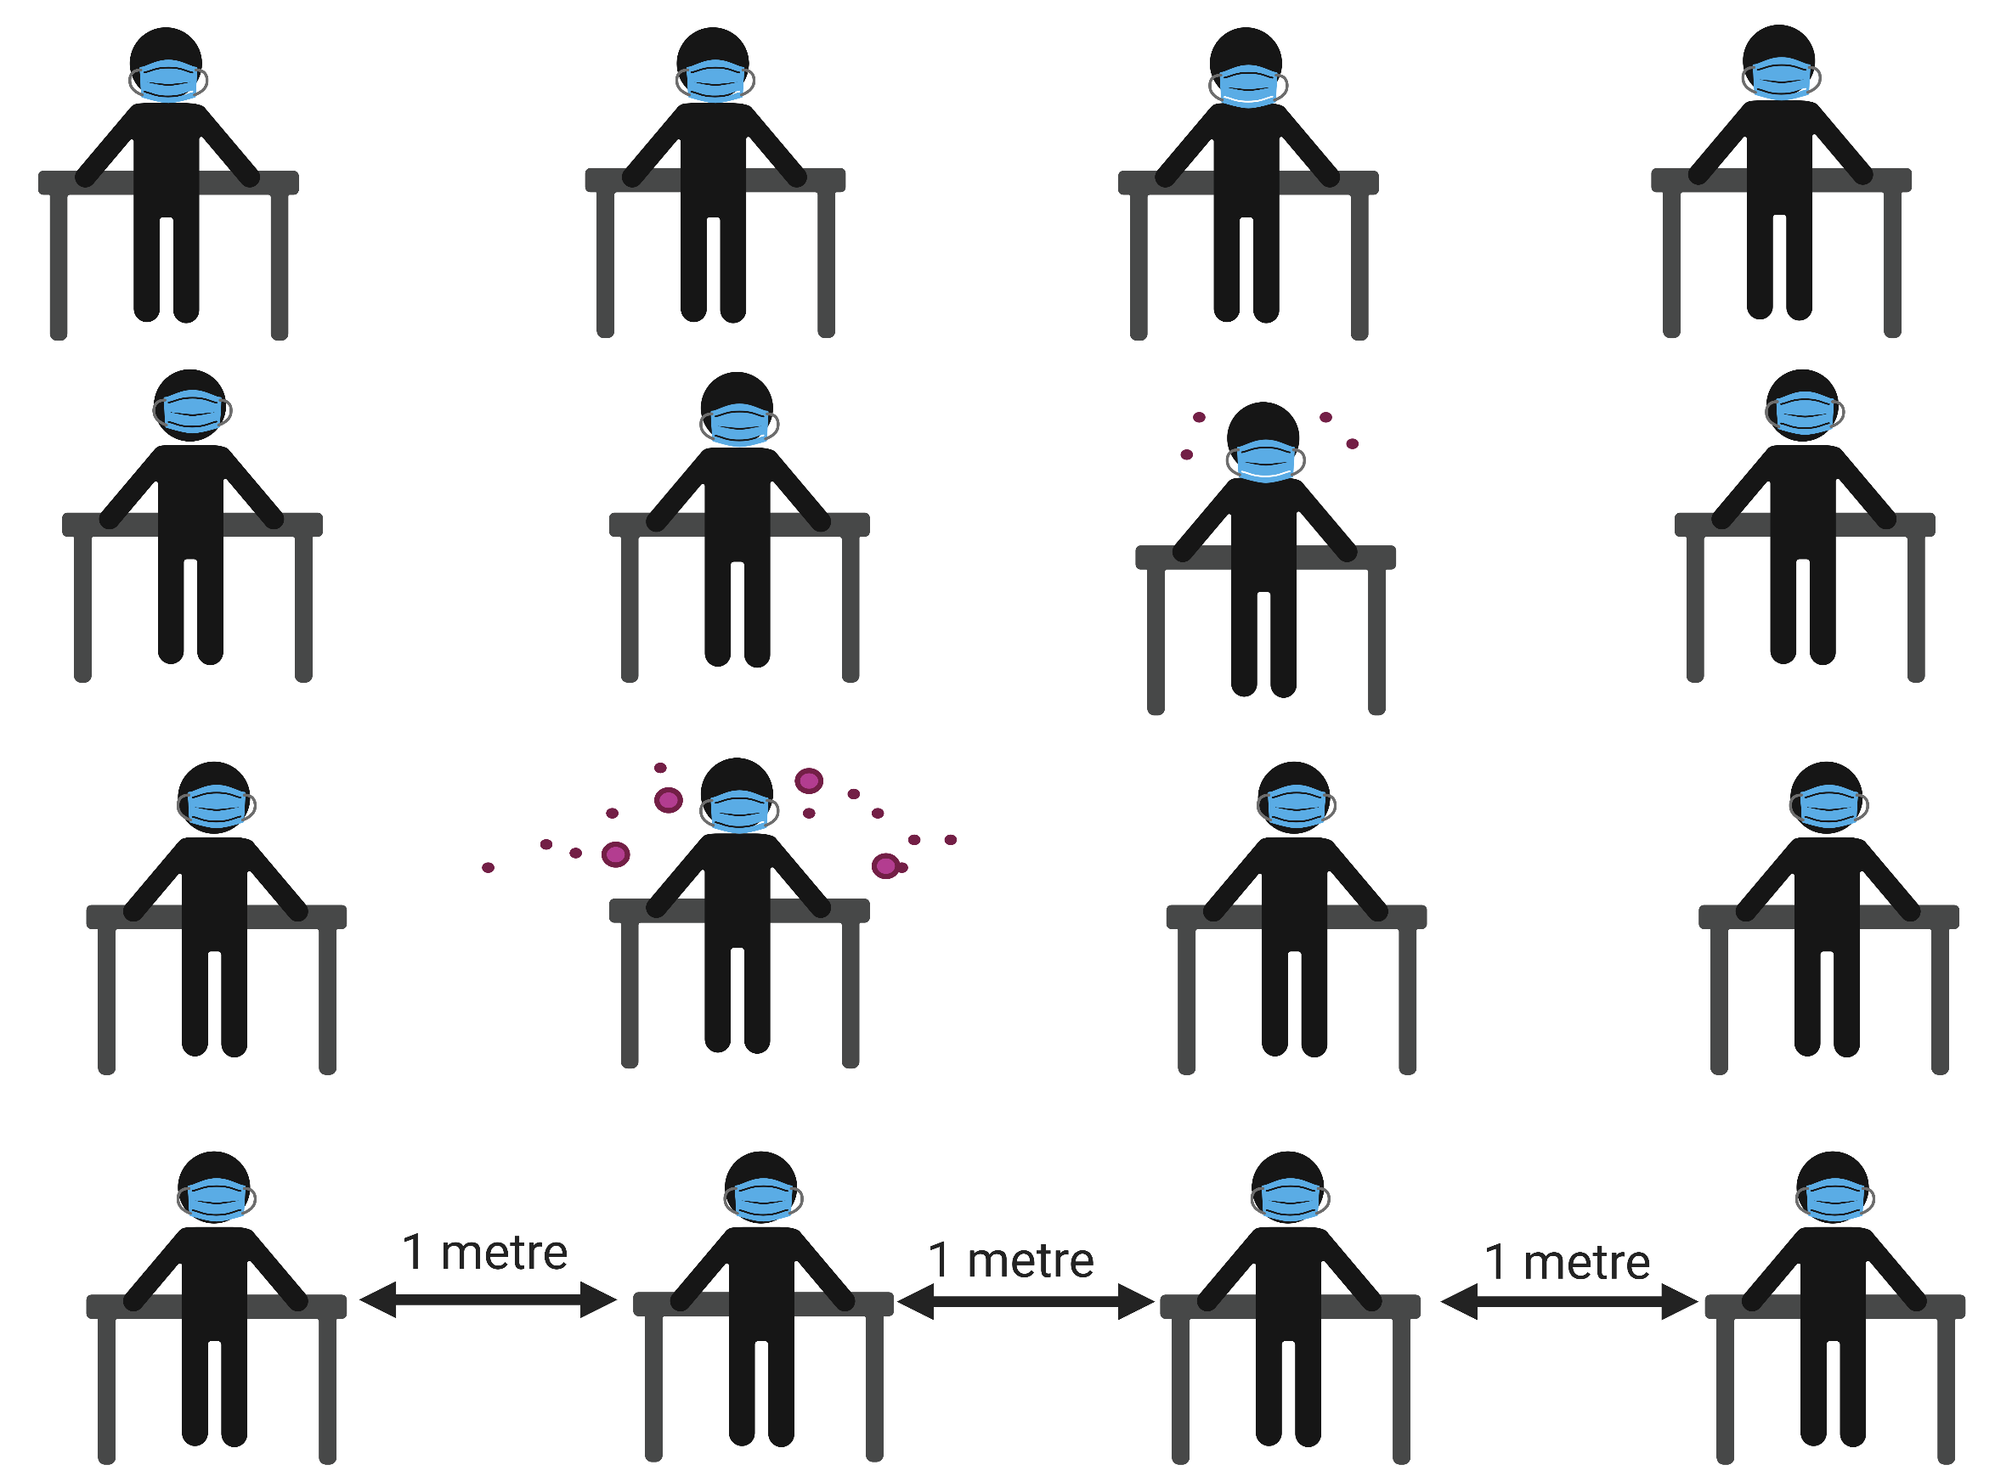

Slide 11
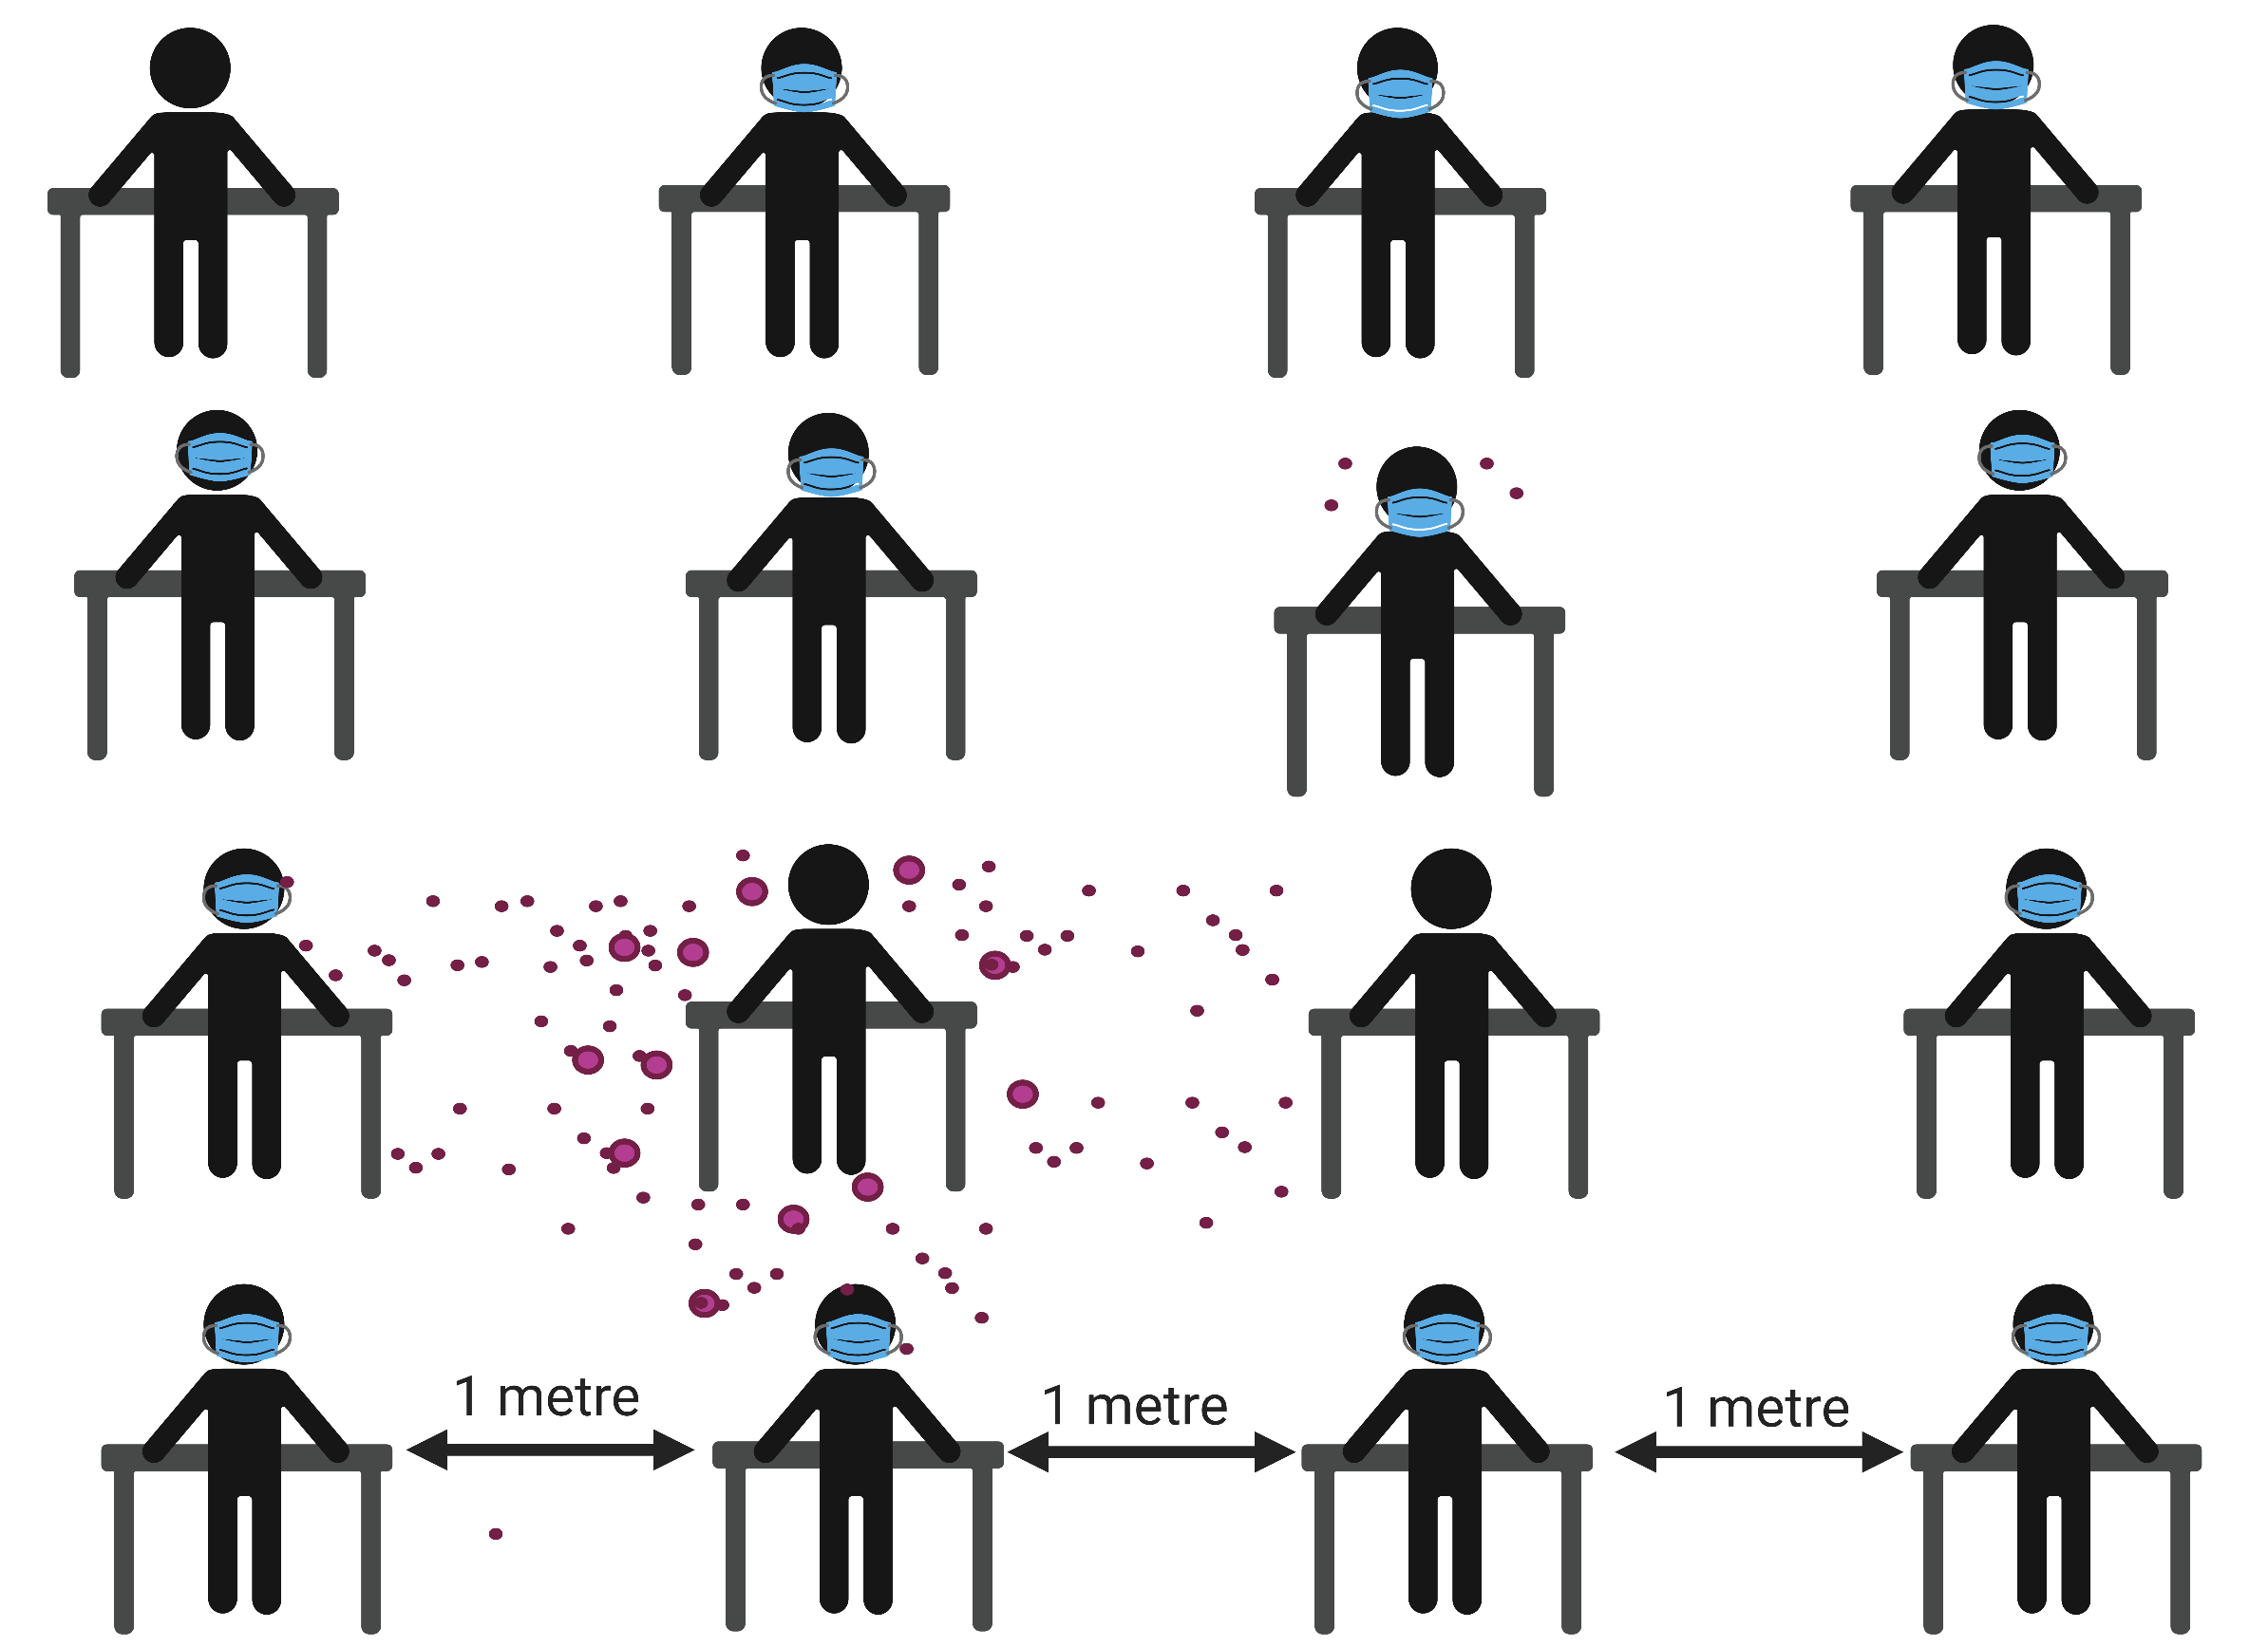

Slide 12
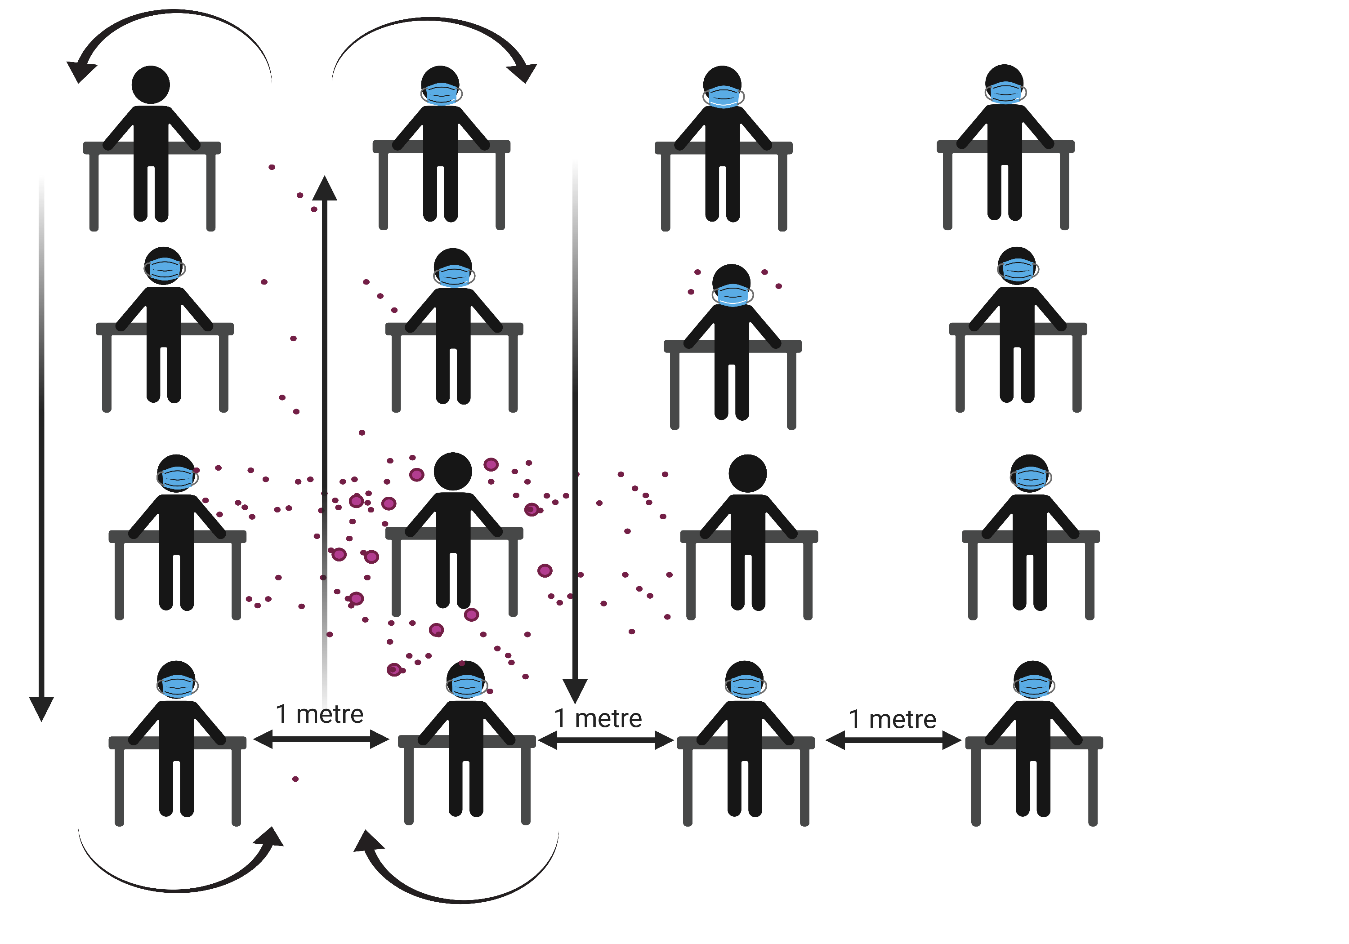

Slide 13
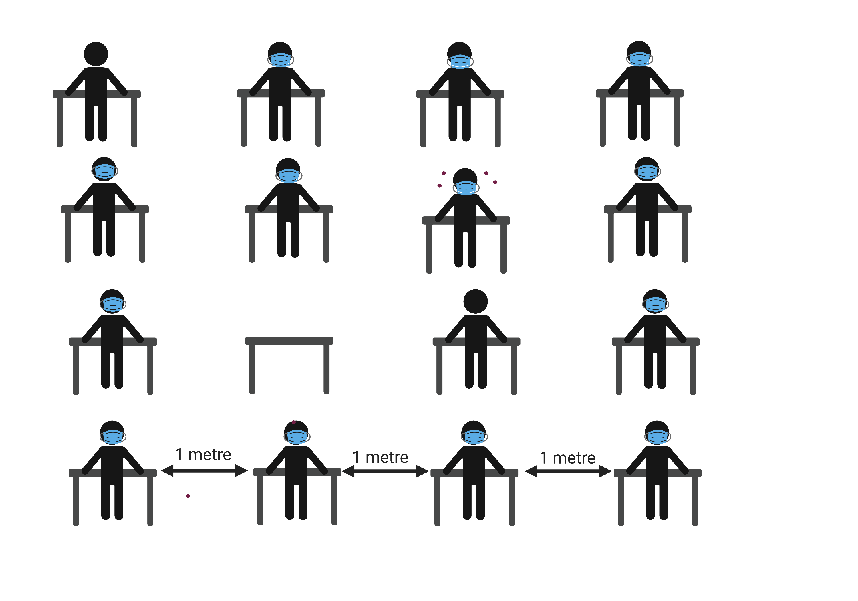

Slide 14
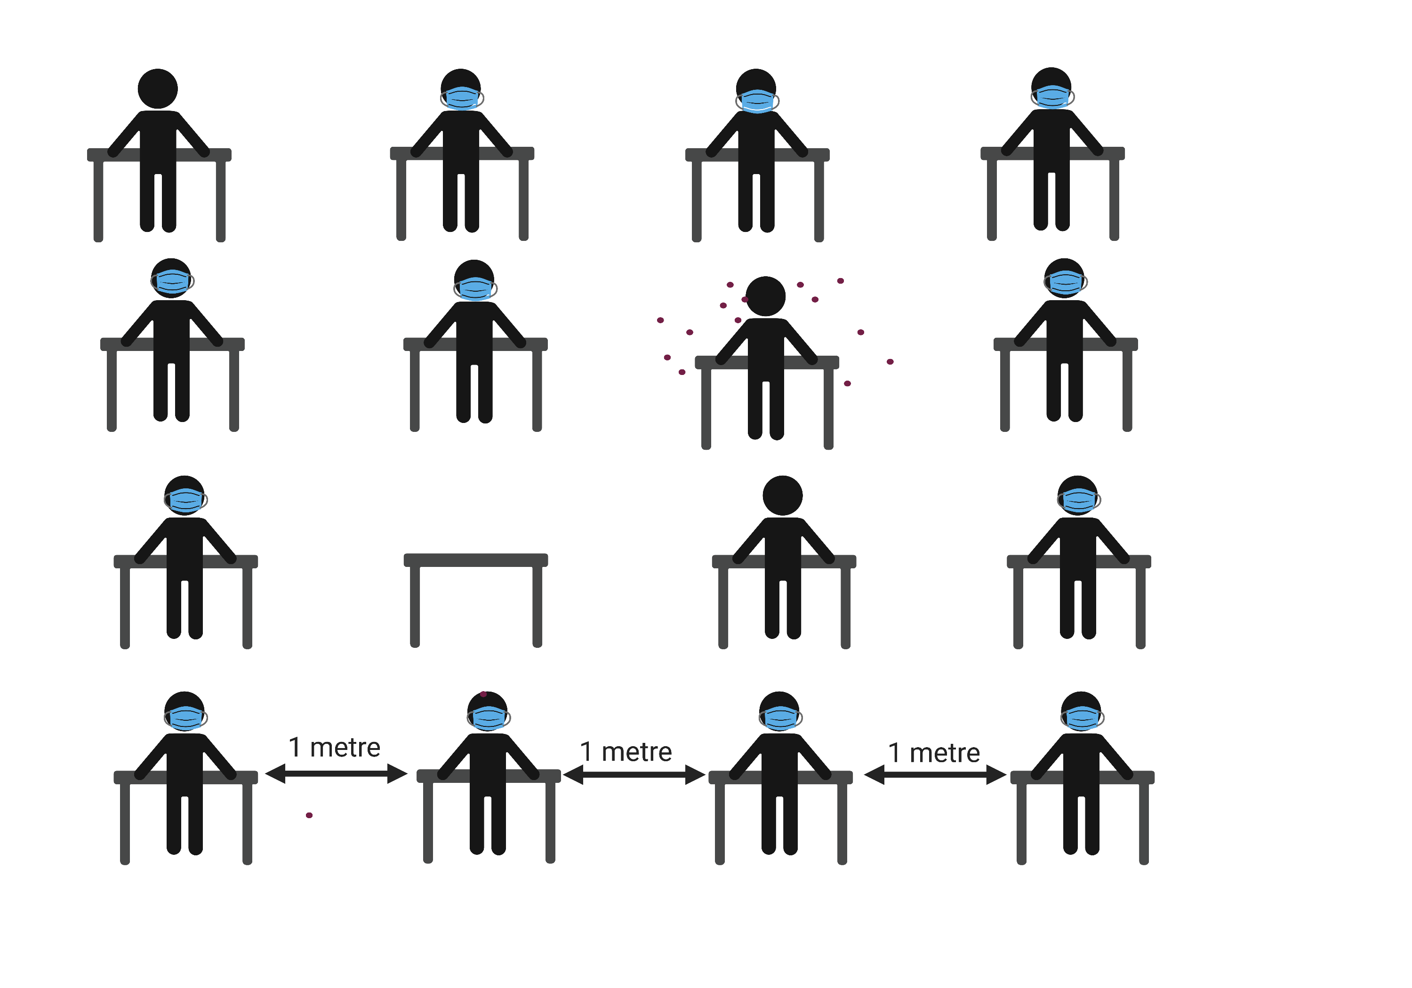

Slide 15
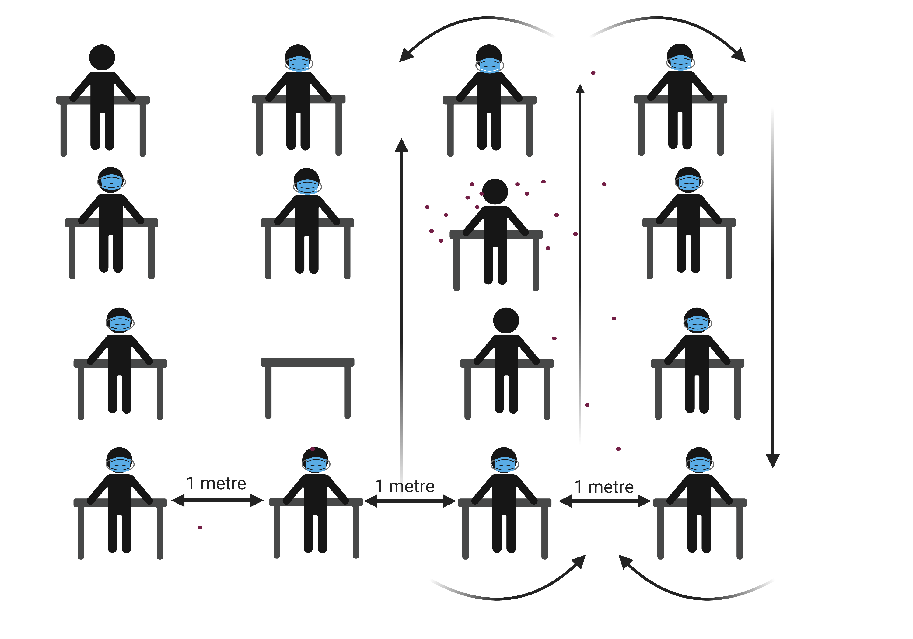
Fisman,D. et al.Bidirectional impact of imperfect mask use on reproduction number of COVID-19: A next generation matrix approach, Infectious Disease Modelling vol 5. 2020. pp405-408

Slide 16
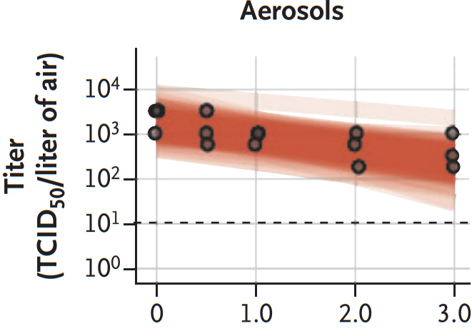
Van Doremalen, Neeltje, et al. "Aerosol and surface stability of SARS-CoV-2 as compared with SARS-CoV-1." New England Journal of Medicine 382.16 (2020): 1564-1567.

Slide 17
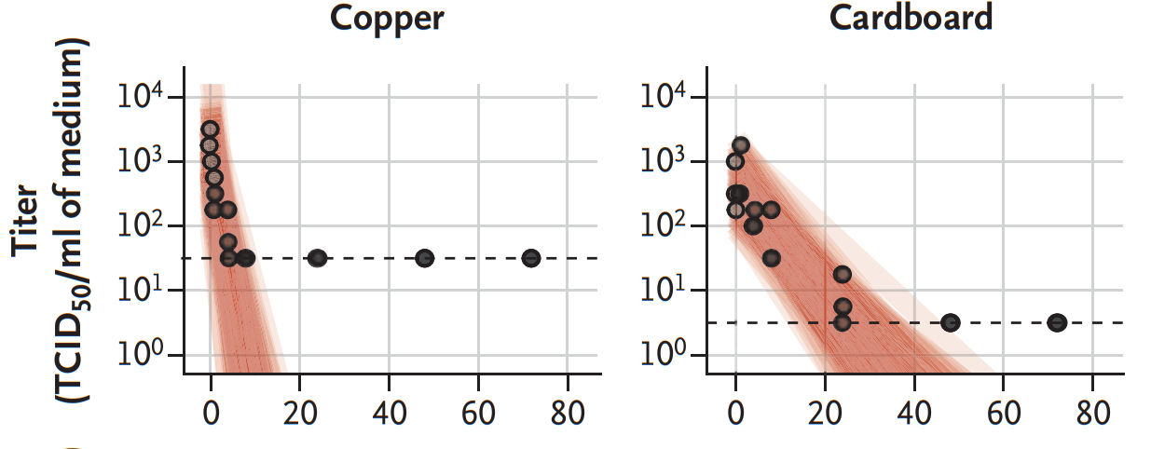
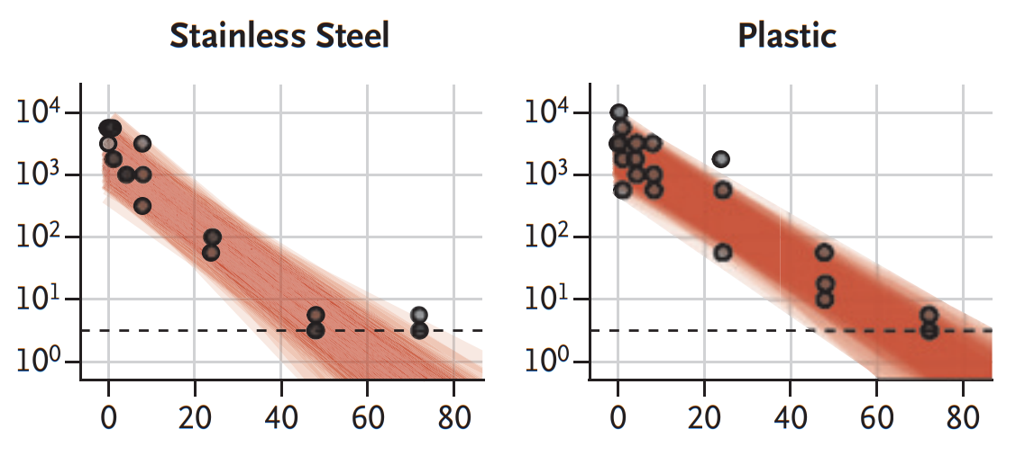
What to clean and when.
High-touch surfaces
Anything coughed or sneezed on or touched by a symptomatic person
Anything that can be left for 3 days is probably ‘clean’
hours
hours
Van Doremalen, Neeltje, et al. "Aerosol and surface stability of SARS-CoV-2 as compared with SARS-CoV-1." New England Journal of Medicine 382.16 (2020): 1564-1567.

Slide 18
Beware the Break Room!
Be as careful around your peers as you are around your students.

Slide 19
Exposure increases with time
Keep symptomatic kids (& teachers) out
Outdoors is much safer than indoors, especially for nutrition breaks, singing & shouting.
Break airflow patterns in classrooms.
Open a door, open one or more windows
Use a fan/air circulator.
Masks, distancing, hand hygiene.
If cleaning is impractical, leaving for three days is good enough.
Next talks: Understanding risk in your own community & when to get
tested if there is an infection in your school.

Slide 20
References & attributions
Figures made with Biorender.com
Transmission by fomites
Effectiveness of social distancing, facemasks, and other measures
Goldman, Emanuel. "Exaggerated risk of transmission of COVID-19 by fomites." The Lancet Infectious Diseases 20.8 (2020): 892-893.
Santarpia, J.L., Rivera, D.N., Herrera, V.L. et al. Aerosol and surface contamination of SARS-CoV-2 observed in quarantine and isolation care. Sci Rep 10, 12732 (2020). https://doi.org/10.1038/s41598-020-69286-3
Chu DK,, et al. Physical distancing, face masks, and eye protection to prevent person-to-person transmission of SARS-CoV-2 and COVID-19: a systematic review and meta-analysis. Lancet. 2020;395(10242):1973-1987. doi:10.1016/S0140-6736(20)31142-9
K. A. Prather et al., Reducing transmission of SARS-CoV-2. Science.10.1126/science.abc6197 (2020).
To download the .ppt slides go to www.bowdish.ca
If modifying please attribute the original publication/data source.

