Slide 1
What is the purpose of holding a journal club!
Educate the presenter and audience regarding topics that might not be mainstream in respect of their research projects.
Develop and hone oral and visual presentation skills.
Learn how to tell a story.
Learn how to answer questions from the audience.
Entertain the audience!
You will be often judged by your skill to deliver a presentation! Preparing a journal club presentation is excellent practice. To do it properly is much more work than just offering a few data slides.

Slide 2
Why should the assigned paper be told as a story?
The story converts the paper into a form that eliminates the details, combines the various sections of the paper (Introduction, Materials & Methods, Results and Discussion) and opens the door for further discussion.
The story makes that paper easier to understand and integrate into existing knowledge.
The story is entertaining!

Slide 3
What are the basic elements of any story?
Prologue…remarks made by the presenter that puts the paper in context for the audience to understand why it was selected. (This is not the Abstract.)
Setting…the Introduction that summarizes the background knowledge needed to understand the basis of the hypothesis being tested.
Conflict…describes alternate hypotheses.
Plot…experimental design, the Material and Methods and the Results.
Resolution…Discussion of the Results to reach a Conclusion(s).
Epilogue…How the conclusion integrates and adds to the current state of knowledge.
Footnotes…can be inserted anywhere to increase clarity or explain other aspects of the story.

Slide 4
Do’s
Assume that many in the audience have not read the paper or, if they did, they might not understand it or are not familiar with the details.
There is no requirement to present the paper in the order it is written.
Add your own insight, comments, conclusions etc. as you prepare the presentation. Do not assume that the audience is aware of these.
Limit your presentation to no more than 25-30 slides per hour. This will be the maximum only if you have to present explanatory details, i.e. a prologue, before delving into the paper.
Present the text large enough to be easily read by distant audience.
Use colour and shapes to highlight the key points. Use bullet points.
Distribute the presentation to the audience prior to your presentation. This way they can make notes in and store the Power Point.

Slide 5
Don’ts
Focus on the major/most important points. Don’t include all of the details in the presentation. These can be added verbally as you present.
Avoid using motion/animation. This is distracting and is difficult to interpret without seeing the whole animation and is not very printable.

Slide 6
Prologue Analogy
Think about the knowledge base of the audience. Do they need supplementary information to understand the various aspects of the paper?
Eg. Most of you are not immunology students and might not have an understanding of the immunologic basis for the paper. Thus, a few remarks are needed to fill this possible avoid
Note: The prologue might or might not be needed depending upon the knowledge base of the audience.

Slide 7
Antibodies are large protein molecules that attach to foreign intruders and substances, thereby preventing them from entering and spreading throughout the body, and marking them for destruction by other elements of the immune system when they do gain access to the body.
There are 5 types of antibodies, each having there own method of action,
IgM, IgD, IgG, IgA & IgE.
Antibodies are secreted by plasma cells.
A plasma cell is derived from a type of cell termed a B lymphocyte (B cell) which, upon coming in contact with an intruder, becomes activated, rapidly undergoes many rounds of cell division (termed B immunoblast division) and such blasts terminally differentiate into a plasma cells that secrete anitbodies.
B cells and plasma cells are not found scattered throughout the body. They reside in specialized sites including:
- lymph nodes and the spleen
- bone marrow
- mucosal lamina propria.
Mucosal surfaces are those interfaced with the external environment…gastrointestinal tract, respiratory tract, urogenital tract, lactating breast tissue ducts, ocular orbits, ear canal.
The lamina propria is the tissue that is found just under the epithelium cell layer which forms the boundary between the mucosal tissue and the outside world.
Foreign material must reach these sites to activate B cells.

Slide 8
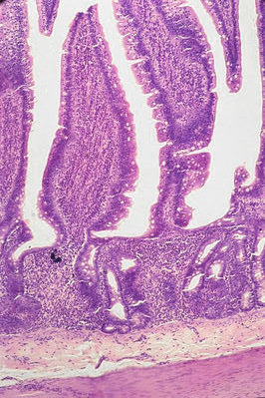
Small Intestine, H&E staining
Intestinal villus
Lamina propria
Submucosa

Slide 9
Today’s Paper
Evidence for a Common Mucosal Immunologic System
Migration of B Immunoblasts into Intestinal, Respiratory and Genital Tissues
J. Immunol. 122:1892 (1979)
This paper concerns the origin of IgA antibodies in the secretions produced at mucosal surfaces.
This paper is a pivotal report as it forms the cellular basis for oral immunization against mucosal pathogens inhabiting various mucosal sites.
End of the Prologue Analogy

Slide 10
The Setting Analogy (Introduction)
What was known at the outset of the investigation?
IgA is the predominant antibody type in mucosal secretions. Very little IgG is present.
IgG is the predominant antibody type in the blood and non-mucosal interstitial fluid (the fluid bathing cells). Little IgA is found here.
IgA containing/secreting plasma cells (also termed plasmacytes) predominate in mucosal lamina propria. Few IgG containing/secreting plasma cells are found here.
IgG containing/secreting plasma cells predominate in lymph nodes and the spleen. Few IgA containing/secreting plasma cells are found here.
This disparity in IgA and IgG plasma cell distribution suggested that two (2) types of B cell compartments/immune systems might exist…mucosal and non-mucosal.
Not stated in the Introduction

Slide 11
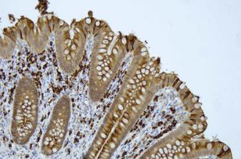
IgA Predominating in the Intestinal Lamina Propria
epithelium
IgA-containing plasma cells stained brown
In the lamina propria

Slide 12
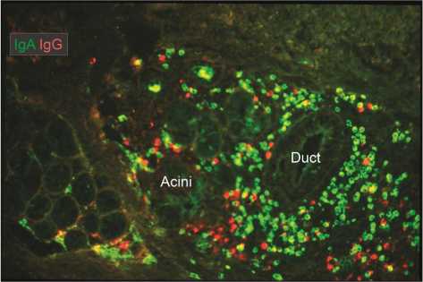
Predominance of IgA Plasma Cells in the Salivary Gland Mucosa
IgA is green
IgG is red

Slide 13
Intestinal (oral) immunization with viable or non-viable material can result in:
- vaccine-specific IgA antibodies in mucosal secretions (in gastrointestinal and respiratory tracts,
eyes, breast, genital tract)
- plasma cells containing vaccine-specific IgA antibodies in mucosal lamina propria (in gut, lungs,
eyes, breast, genital tract).
Oral immunization with non-viable material does not produce much vaccine-specific IgG in mucosal secretions or many vaccine-specific IgG plasma cells in any mucosal lamina propria.
In contrast, systemic immunization produces little specific IgA in blood and non-mucosal interstitial fluid and few vaccine-specific IgA plasma cells in lymph nodes and the spleen.
However, systemic immunization produces lots of specific IgG in blood and non-mucosal interstitial fluid and many specific IgG plasma cells in lymph nodes and the spleen.
These observations reinforce the idea that two (2) types of B cell compartments/immune systems might exist…mucosal and systemic compartments.
Not stated in the Introduction
End of the Setting Analogy

Slide 14
The Conflict Analogy ( Possible Hypotheses)
How can we explain the predominance of IgA, but little IgG in external secretions?
How can we explain the predominance of IgG, but little IgA in blood/interstitial fluid?
Hypothesis 1:The small IgA concentration in the large volume of blood is selectively transported across
the lamina propria into external secretions. There is some evidence to support this notion.
(This does not explain the absence of IgG in external and suggests a special transport
system for IgA.)
Hypothesis 2: IgA plasma cell progenitors, activated in the intestine, migrate selectively back to the gut
lamina propria and to distant mucosal lamina propriae where they complete differentiation
into IgA plasma cells and the IgA secreted by these is transported into external secretions.
Activated IgG progenitors are not produced in the intestine but are produced in lymph
nodes and the spleen and selectively migrate to all lymph nodes and spleen but not to
mucosal sites.
This second hypothesis suggests that there are special receptors on IgA and IgG
progenitors that govern their movement and final residence.

Slide 15
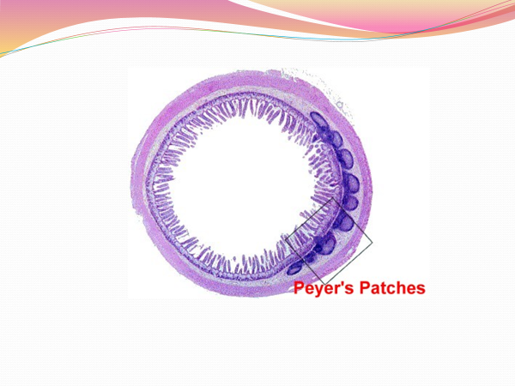
Support for Hypothesis 2 as the Major Mechanism
After oral immunization, resistance to gut infection was not correlated with blood antibodies.
IgA progenitors arise in the Peyer’s Patches, lymph node-like structures embedded in the gut wall.
IgA progenitors from the Peter’s Patches travel to the intestinal (mesenteric) lymph nodes and then travel to the intestinal and breast lamina propria.
Cross section of mouse small intestine

Slide 16
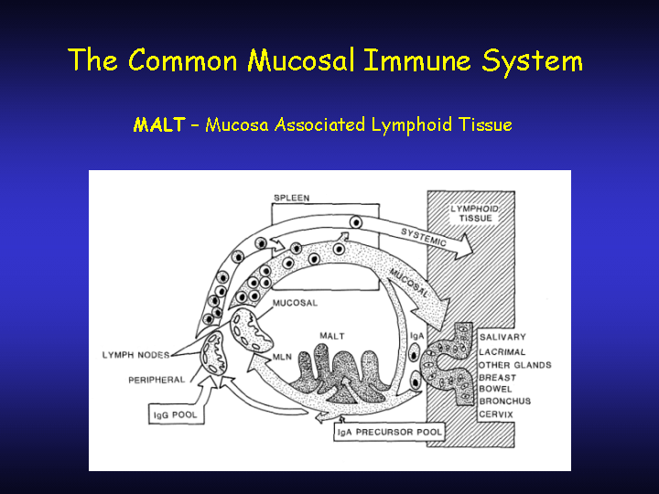
These data suggest a model to be tested:
Peyer’s Patches
This model is not proposed this early in the paper. It is brought forward from the Discussion. It helps the audience understand where the paper is going.
End of the Conflict Analogy

Slide 17
The Plot Analogy (Experimental Design, Methods and Results)
Using a Mouse Model to Determine the Movement of Activated B Immunoblasts
The Model Concept
A small number of B cells (~1% or less) in various mucosal and systemic lymph nodes are always activated, ie., are immunoblasts, by environmental substances, generally microbes.
These B immunoblasts (B cells making DNA) can be detected by labelling them with radioactive thymidine (3H-Tdr), a DNA precursor nucleoside that emits a Beta particle when the 3H atom decays.
Thus, radiolabelled B immunoblasts can be detected and the presence of IgA or IgG in their cytoplasm can be revealed by staining such cells with rabbit anti-mouse IgA or IgG tagged with a fluorescent dye.

Slide 18
Method Summary
Combined Immunofluoresence & Autoradiography
Remove lymph nodes from donor Mice
-mesenteric (MLN) and bronchial (BLN)… (mucosal)
-axillary, brachial and inguinal (PLN) … (non mucosal)
Prepare single cell suspensions of MLN, BLN & PLN
Radiolabel immunoblast DNA in each suspension by incubation 3H-Tdr
Intravenously inject each cell suspension into individual recipient mice (termed adoptive transfer of cells)
Quantitate the number of labelled cells containing IgA or IgG in the tissue sections
Wait 24h for silver grain exposure
Remove various tissues and prepare thin sections of each onto microscope slides
Examine slides with microscope that has ultraviolet and white light illumination capability
Coat microscope slides with photographic emulsion
Wait several days for exposure by 3H-Tdr
Stain tissue sections with fluorescent antibodies that bind to mouse IgA or IgG
Develop photographic emulsion to reveal immunoblasts

Slide 19
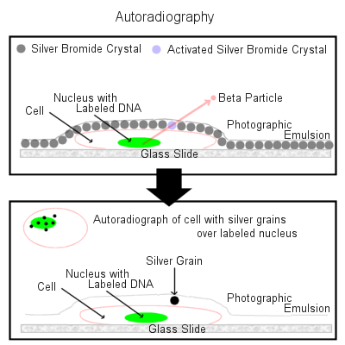
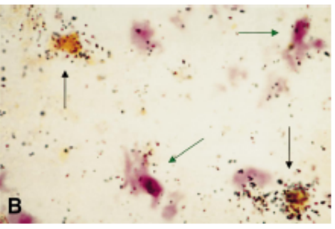

Slide 20
Experimental Design Assumptions
Mechanically releasing cells from lymph nodes approximates their normal migration out of these organs.
Only immunoblasts incorporate 3H-TDR.
The presence of radioactivity within cells does not alter their normal migration patterns.
The time points used in the study allow migrating cells to reach their final destination.
Radiolabelled cells in a disc volume of tissue viewed with a microscope are representative of such cells distributed throughout the entire tissue.

Slide 21
Question 1
Compared to PLN cells (non-mucosal), do MLN and BLN cells (mucosal), preferentially travel to distant intestines, lungs or lymph nodes?
Answer: Yes!

Slide 22
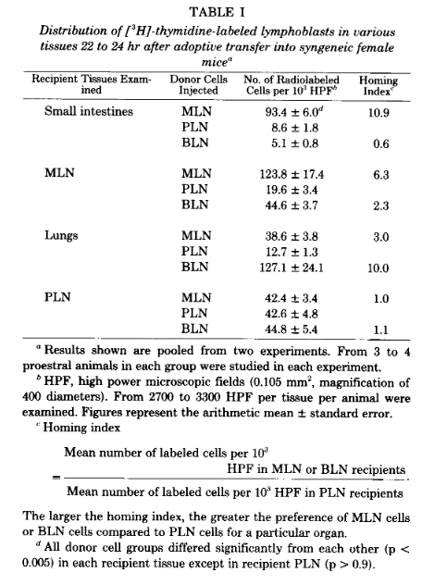
MLN cells were 3.0-10.9 fold more prevalent than PLN in intestines, lungs and MLN, all tissues associated with mucosal sites.
MLN were found in the mucosal lamina propriae.
MLN cells were not found in the Peyer’s Patches or the bronchus-associated lymphoid tissue (BALT), the Peyer’s Patch equivalent in the lungs or in the PLN in significant numbers.
PLN cells returned principally to PLN, their sites or origin. A few were found in mucosa sites.
BLN cells returned principally to the lung mucosa.
Conclusion: There is selective localization (homing) of trafficking immunoblasts. Those derived from mucosal sites travel to mucosal sites while those derived from non-mucosal sites travel to non-mucosal sites.
Not at this point in the paper.

Slide 23
Question 2
Compared to PLN cells (non-mucosal), do MLN cells (mucosal), preferentially travel to distant reproductive (mucosal) tissues?
Answer: Yes!

Slide 24
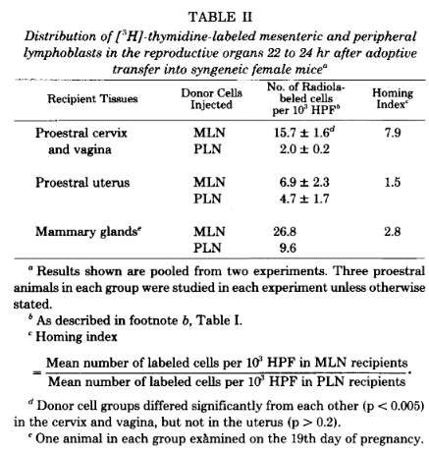
MLN immunoblasts were 2.8 to 7.9 fold more prevalent than PLN in reproductive tissues, all mucosal sites.
MLN were found in the mucosal lamina propriae of these tissues.
Some PLN cells were found in the reproductive tissues.
Conclusion: There is selective localization (homing) of trafficking immunoblasts. Those derived from mucosal sites travel to mucosal sites in reproductive tissues.

Slide 25
Question 3
Compared to non-mucosal immunoblasts (PLN), do the mucosal immunoblasts found in the intestines, lungs and MLN (mucosal) predominantly contain IgA?
Answer: Yes!

Slide 26
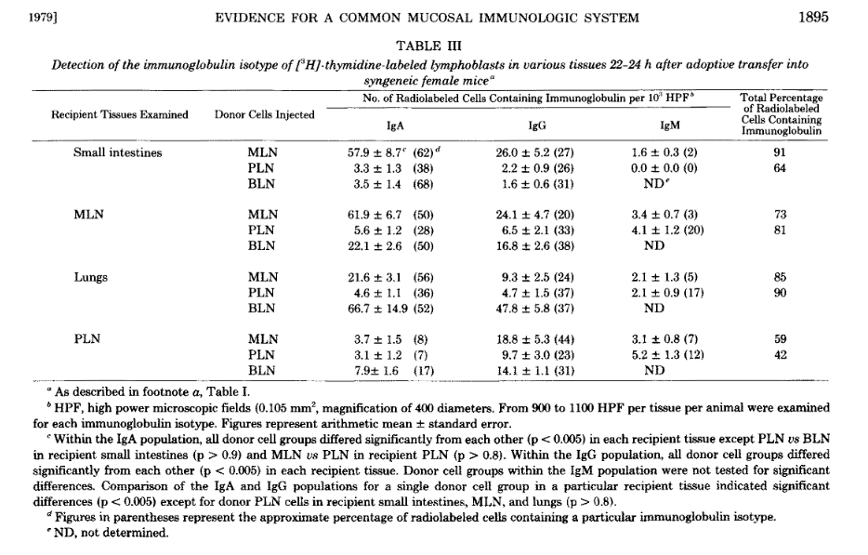

Slide 27
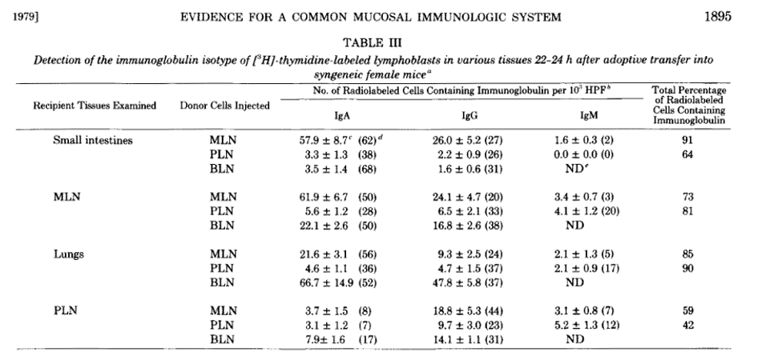
What are the non-antibody containing cells?
Percentage
The majority (50-62%) of MLN and BLN immunoblasts in the intestine, lungs and MLN contained IgA.
Some MLN lymphoblasts (20-27%) at these mucosal sites and in the PLN contained IgG. Few contained IgM.
Conclusion: Most mucosally-derived lymphoblasts selectively localizing at mucosal sites make IgA.

Slide 28
Question 4
Compared to non-mucosal immunoblasts (PLN), do the mucosal immunoblasts found in reproductive tissues(mucosal) predominantly contain IgA?
Answer: Yes!

Slide 29
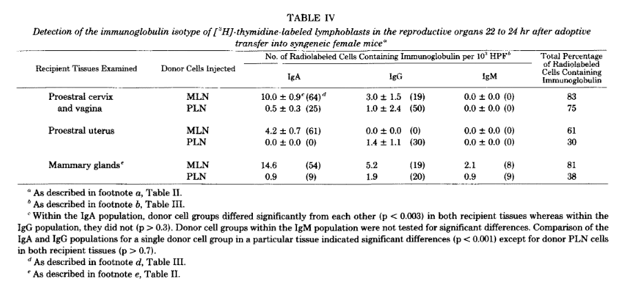

Slide 30
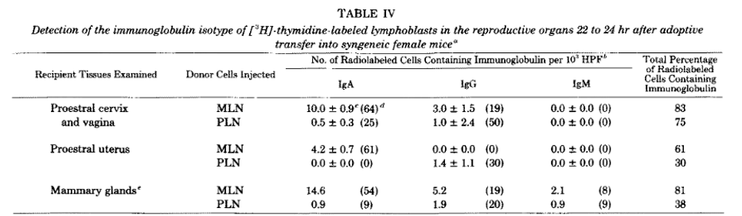
The majority (54-64%) of MLN and BLN immunoblasts in reproductive tissues contained IgA.
Some MLN lymphoblasts (0-19%) at these mucosal sites and in the PLN contained IgG. Few contained IgM.
Conclusion: Most mucosally-derived lymphoblasts selectively localizing at mucosal sites make IgA.
End of the Plot Analogy

Slide 31
The Conflict Resolution (Discussion and Conclusions)
MLN lymphoblasts (and a few PLN lymphoblasts) selectively localize (home) to intestinal, respiratory and reproductive tissues where they are primarily IgA-containing cell precursors.
PLN lymphoblasts selectively localize in the sites from which they arose and are the precursors of IgG-containing cells.
BLN lymphoblasts principally home to the respiratory tract.
The data support the concept of a Common Mucosal Immune System (CMIS) in which IgA precursor cells (as blasts) arise in the Peyer’s Patches (and BALT), travel to their draining lymph nodes (MLN and BLN, respectively) and complete differentiation into IgA secreting plasma cells in the lamina propria. Such IgA is transported subsequently into external secretions.
In contrast, PLN give rise to IgG plasma cells that take up residence in PLN and not in mucosal sites.
The data support the division of the B cell compartment into mucosal and peripheral components.
The CMIS model defines the cellular basis for the predominance of IgA in mucosal secretions and not in the blood.

Slide 32
The data also indicate that the compartmentalization of the B cells is not perfect. There is some “crossover” between the compartments.
End of Resolution Analogy

Slide 33
The Epilogue Analogy
The paper explains, in part, why systemic immunization is ineffective in eliciting mucosal immunity to a significant degree as activated non-mucosal B cells do not home to mucosal sites and do not make IgA.
The paper explains, in part, why mucosal immunization is effective in eliciting mucosal immunity because activated mucosal B cells home to mucosal sites and make IgA.
The paper implies that intestinal or respiratory immunization would be predicted to elicit IgA responses in the gut and lungs, and at distant mucosal sites. Systemic immunization would not be expected to do this.
Oral and respiratory immunization vs systemic immunization supports the predictions emerging form these studies.

